Slide 1
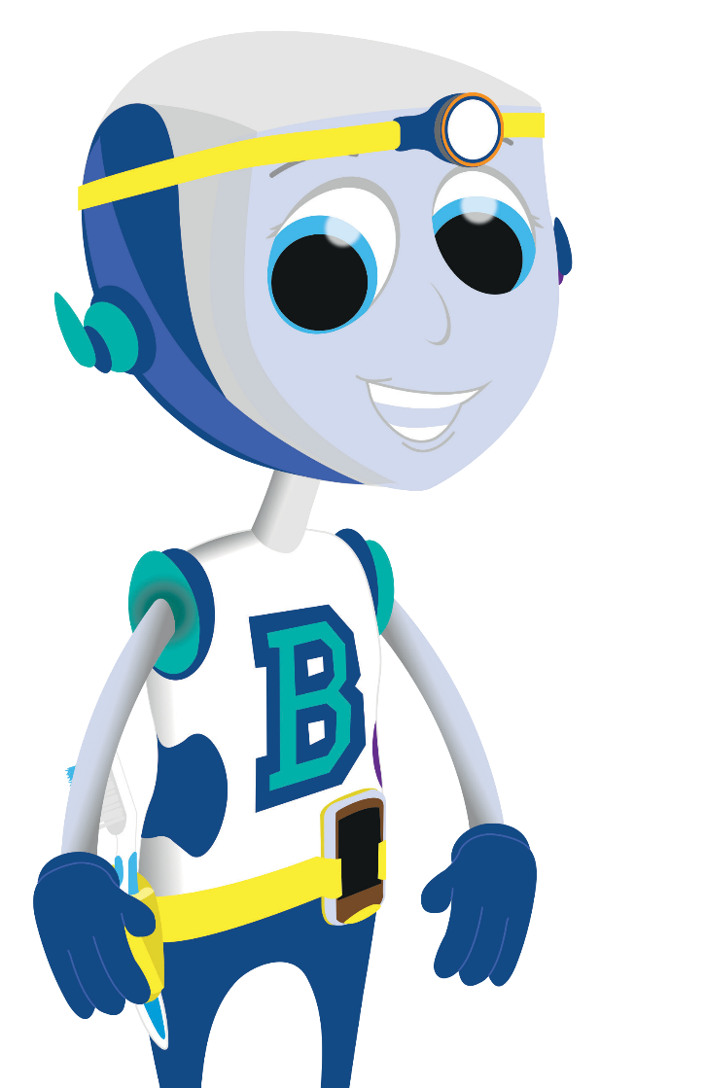
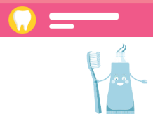
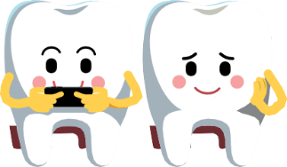
First visit to the dentist
Dentist

Slide 2
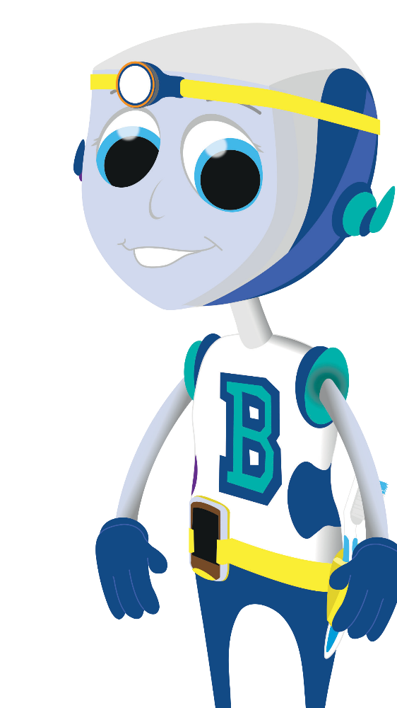
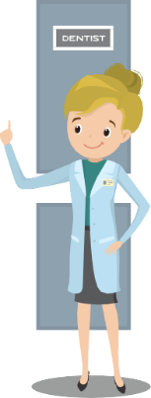
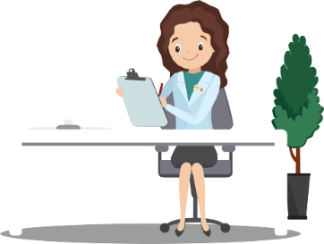
You go to the desk and tell the receptionist your name. She will tell the dentist that you have arrived.
© Oral Health Foundation www.dentalhealth.org

Slide 3
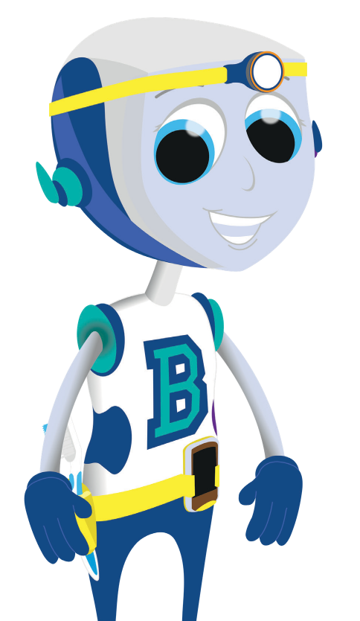
You will then have a seat in the
waiting room.
© Oral Health Foundation www.dentalhealth.org

Slide 4
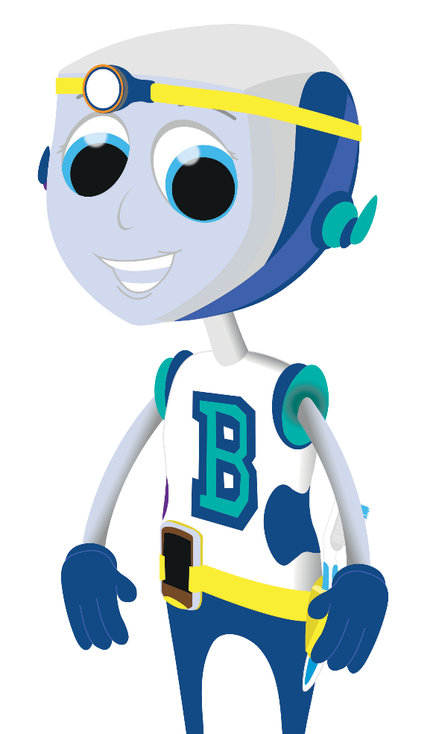
When the dentist is ready for you, the dental nurse will come to the waiting room and call your name.
© Oral Health Foundation www.dentalhealth.org

Slide 5
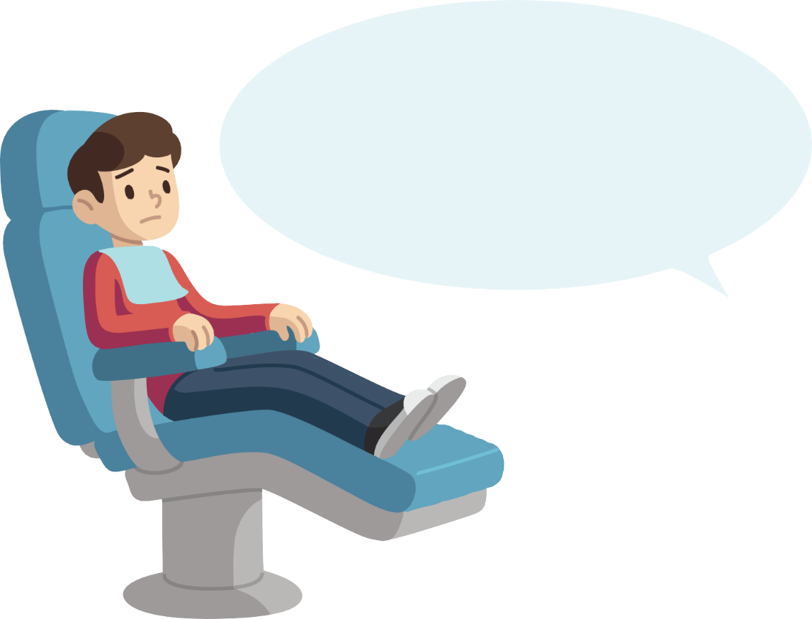
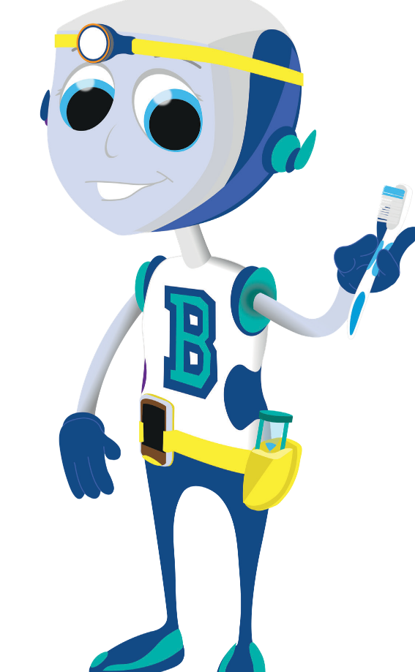
The dentist will ask you to sit in the big, special chair.
© Oral Health Foundation www.dentalhealth.org

Slide 6
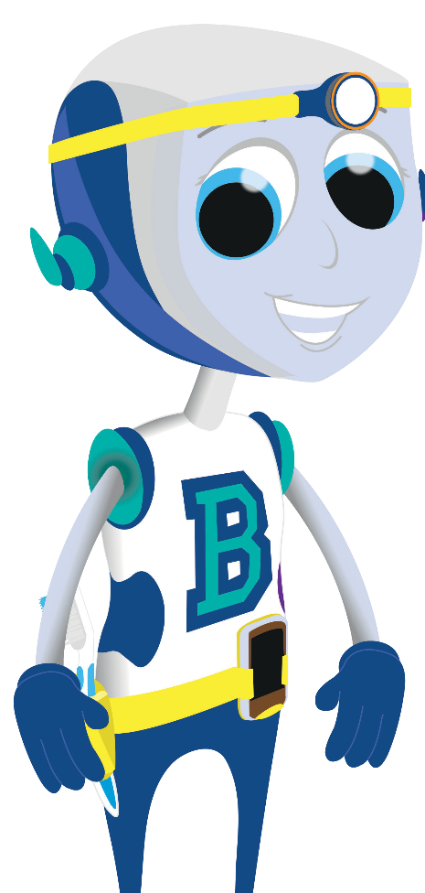
When you sit in the chair, the dentist will press a button and the special chair
will move.
It will lie you down - like you are in bed.
It is very comfy.
© Oral Health Foundation www.dentalhealth.org

Slide 7
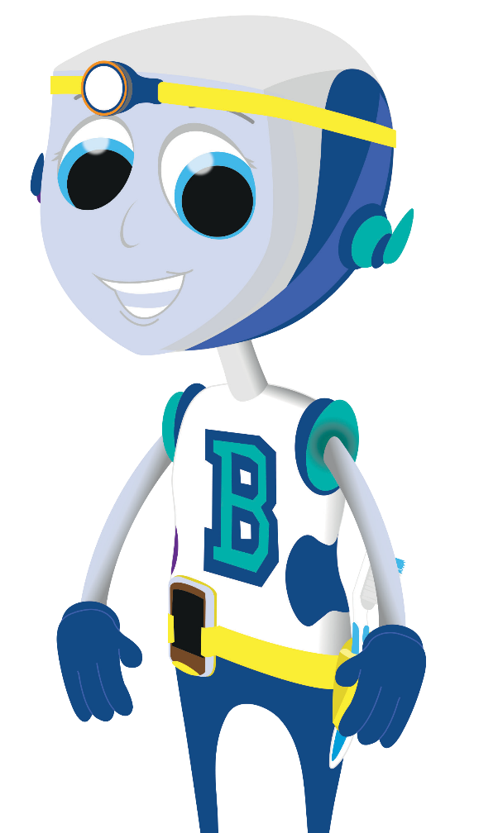
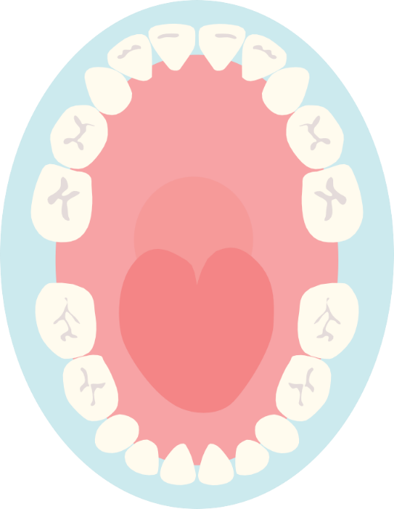
The dentist will say ‘open wide’ and when you open your mouth...
...the dentist will use a tiny mirror on a stick to look
into your mouth and count your teeth.
© Oral Health Foundation www.dentalhealth.org

Slide 8
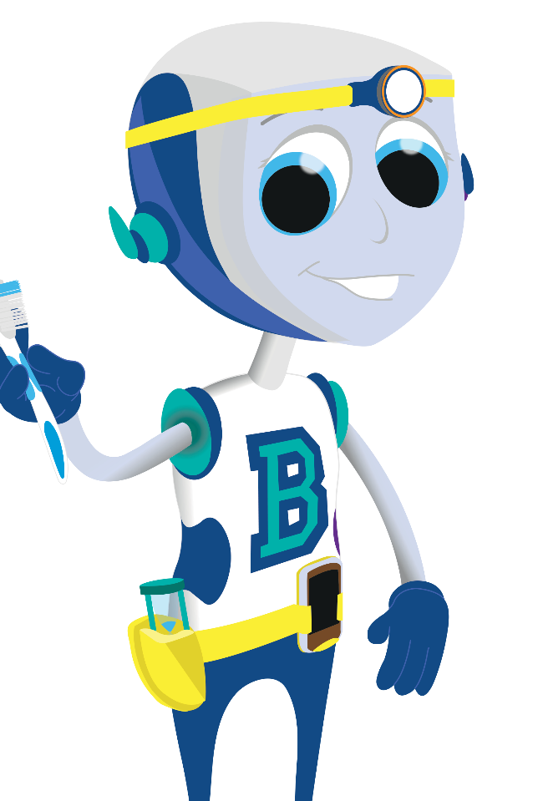
The dental nurse will write down the number of teeth that you have.
20
© Oral Health Foundation www.dentalhealth.org

Slide 9
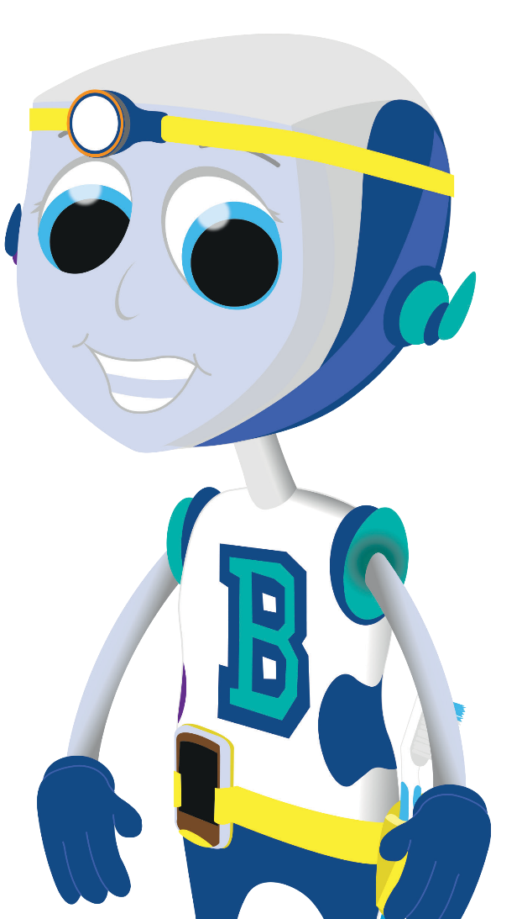
When the dentist has counted all your teeth, they will press the button again...
...and the special chair will sit you up again so you can hop off.
© Oral Health Foundation www.dentalhealth.org

Slide 10
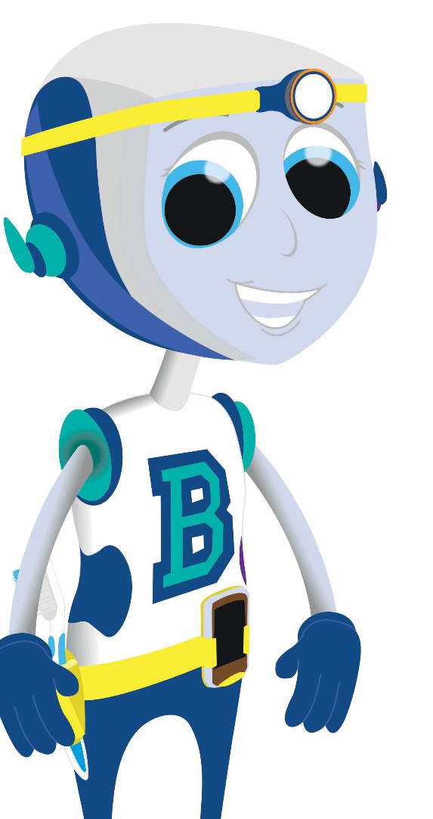
The dental nurse will give you a sticker for being an amazing patient.
© Oral Health Foundation www.dentalhealth.org

Slide 11
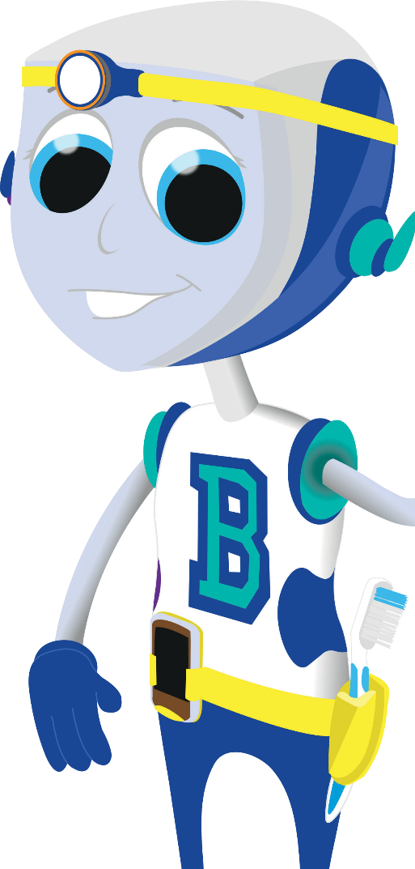
Your dental check-up is now finished, so you will go back to see the receptionist who will make another appointment for next time.
© Oral Health Foundation www.dentalhealth.org

