Slide 1
Food
& Drink

Slide 2
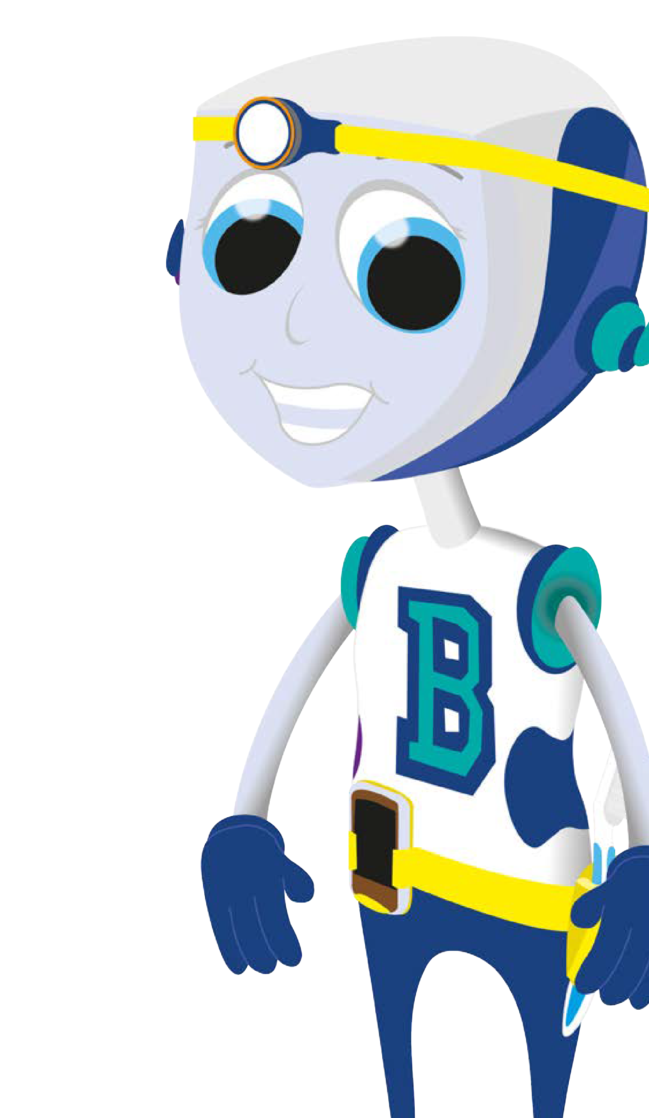
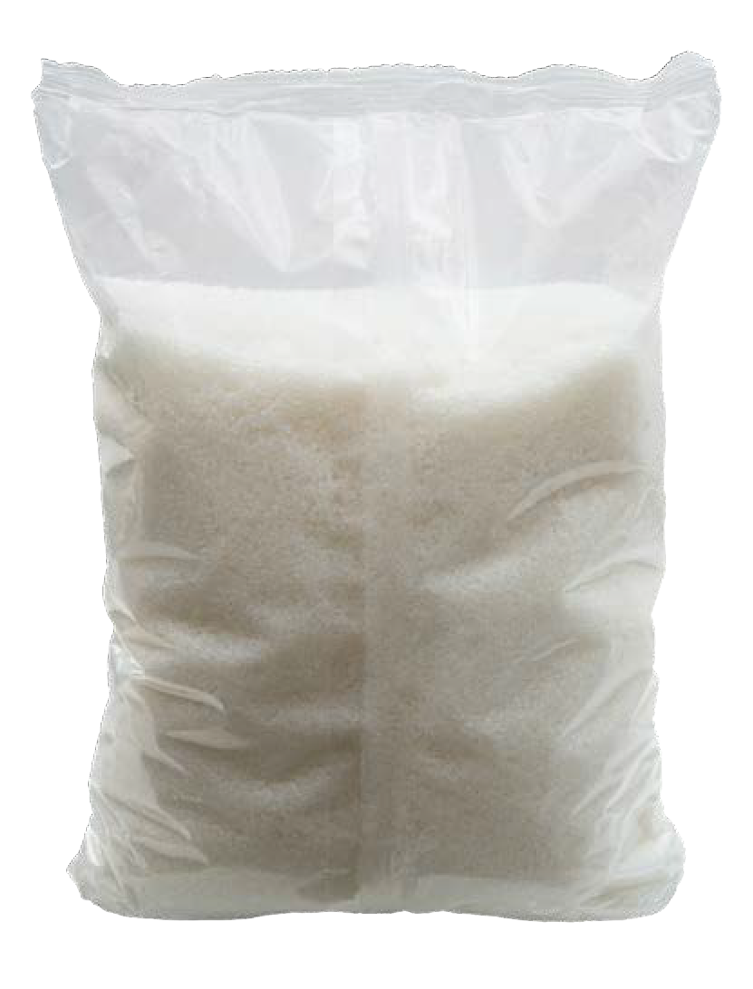
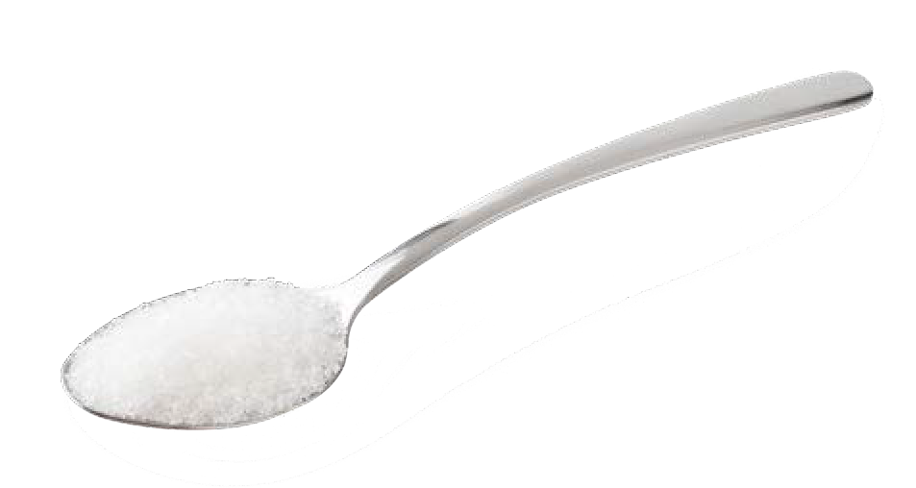
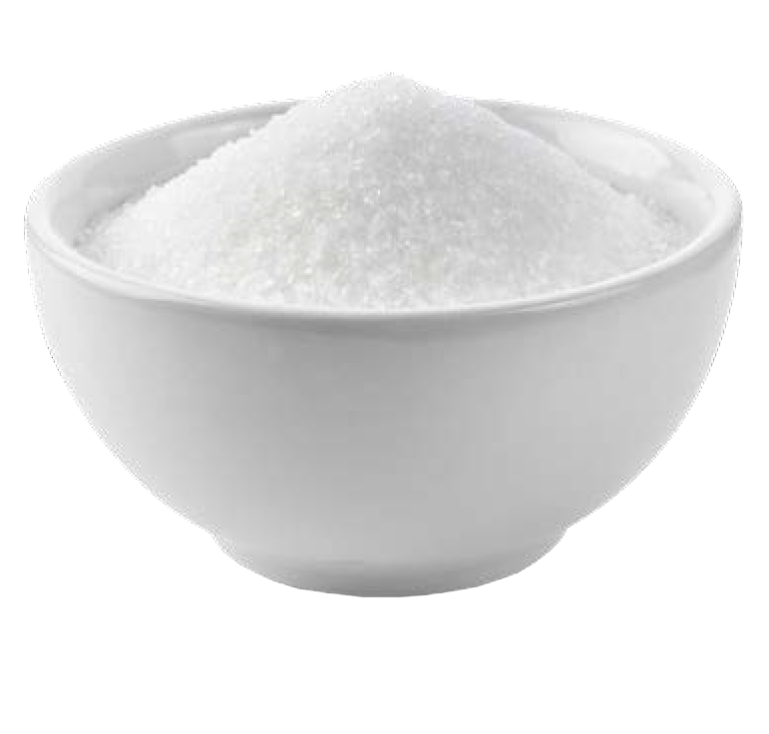
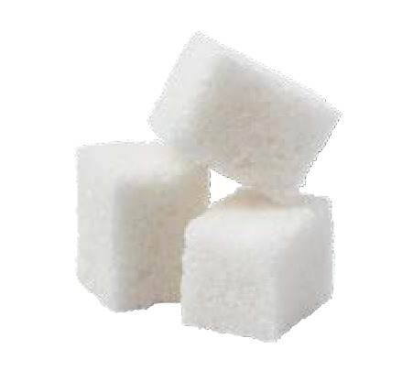
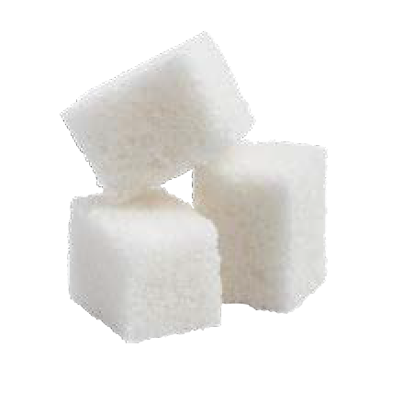
Some foods and drinks are good for
Sugar is not good for our teeth.
our teeth.
We should try not to eat or drink things that contain sugar.
© Oral Health Foundation www.dentalhealth.org

Slide 3
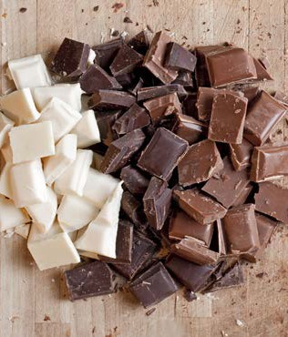
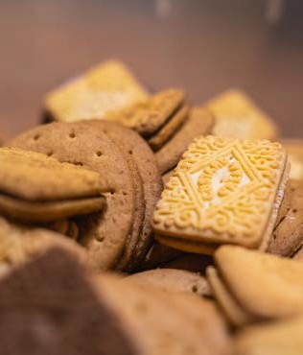
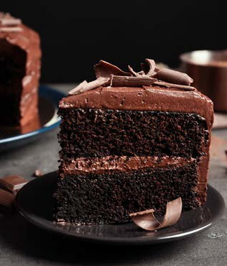
Things that are not good for our teeth:
Sweets • Chocolate Biscuits • Cakes
© Oral Health Foundation www.dentalhealth.org

Slide 4
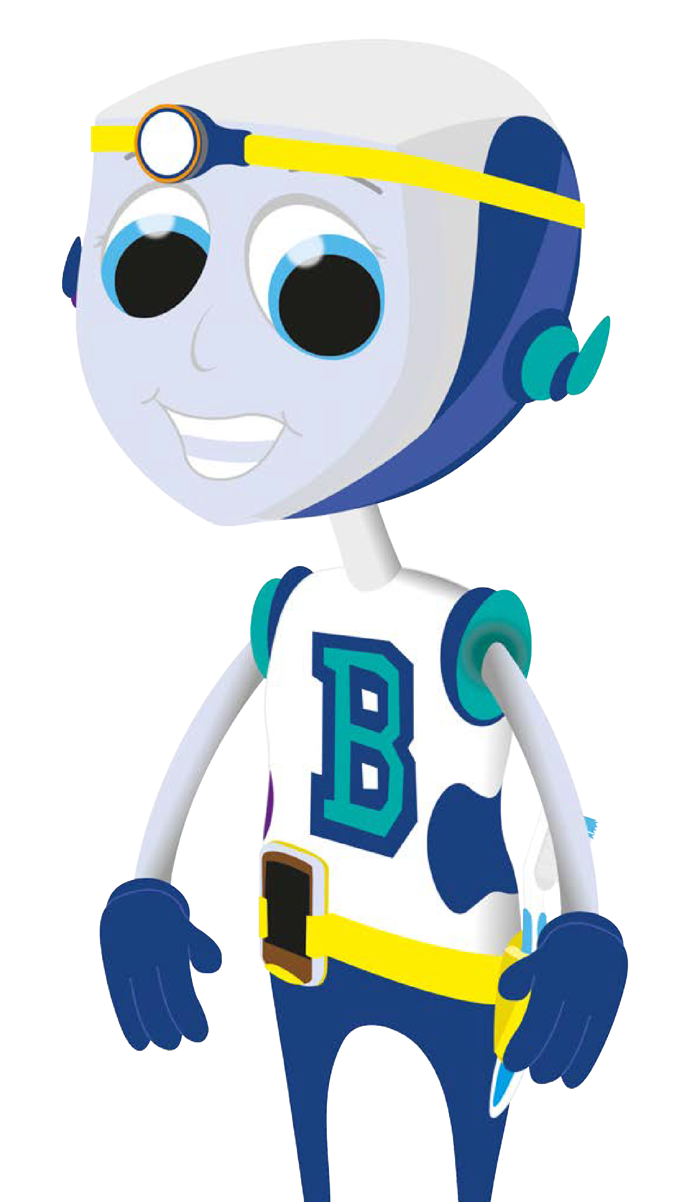
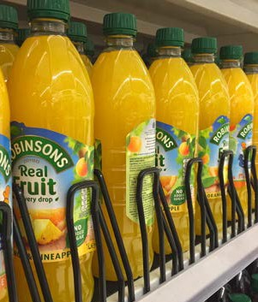
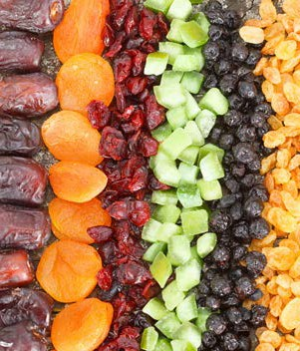
More things that are not good for our teeth: Fizzy Drinks • Fruit Juice Squash • Dried Fruit
© Oral Health Foundation www.dentalhealth.org

Slide 5
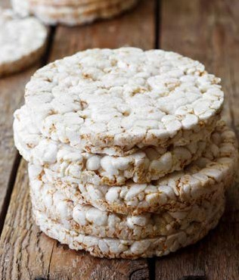
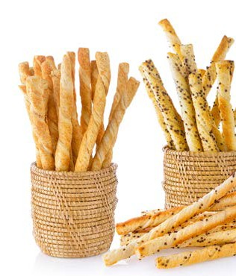
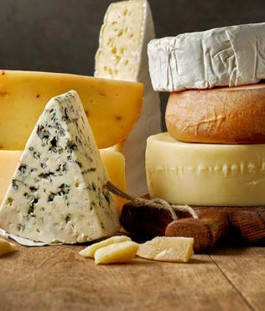
Things that are good for our teeth:
Rice Cakes • Bread Sticks Cheese
© Oral Health Foundation www.dentalhealth.org

Slide 6
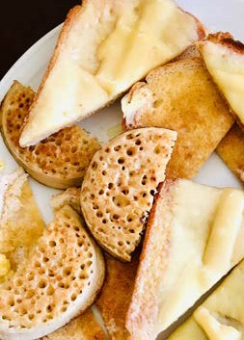
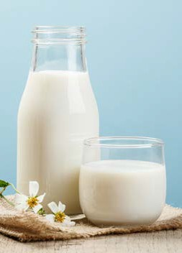
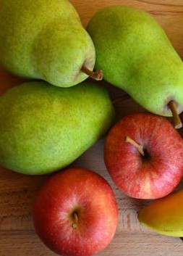
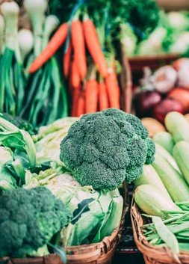
More things that are good for our teeth:
Toast & Crumpets • Milk & Water • Fruit & Veg
© Oral Health Foundation www.dentalhealth.org

Slide 7
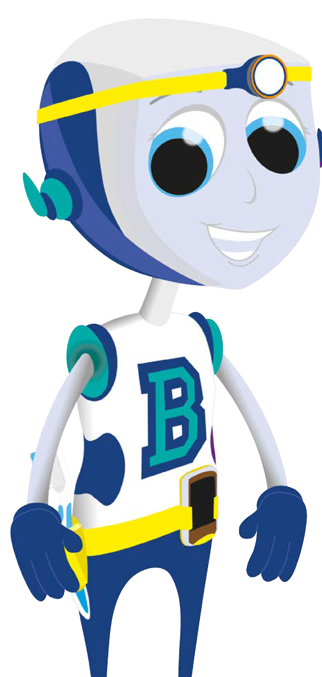
The bugs that live in our mouth, love to eat sugar.
When they eat sugar, they get big and strong and make acid which can start to make holes in our teeth.
© Oral Health Foundation www.dentalhealth.org

Slide 8
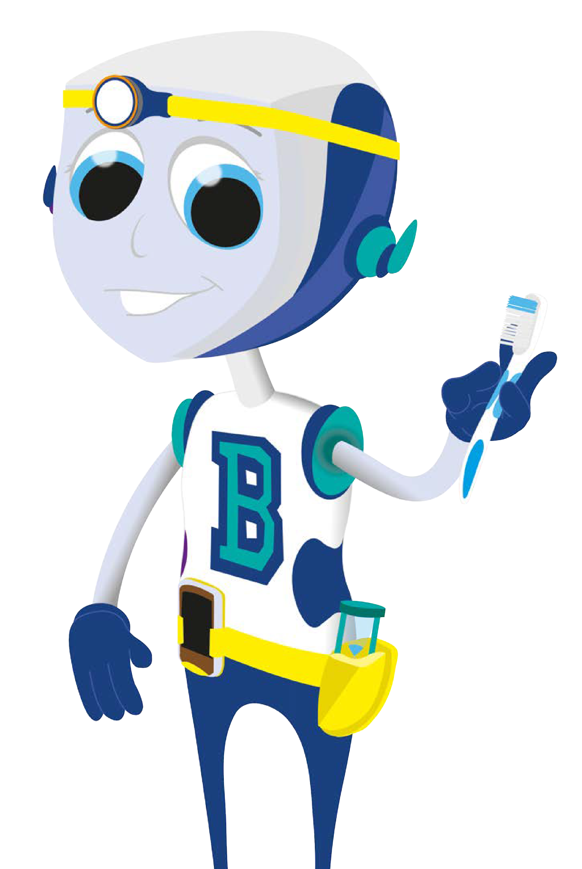
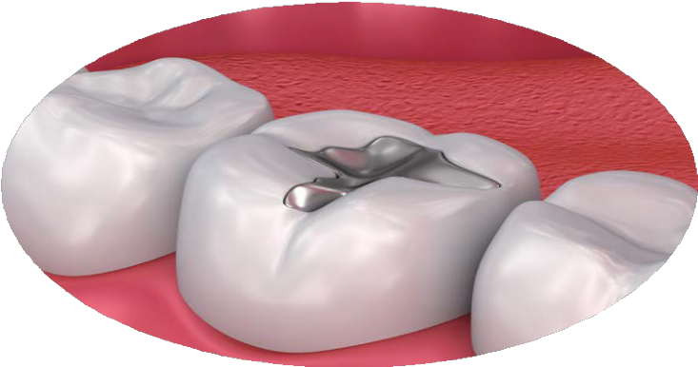
If we have too much sugar, too often, the dentist will have to fix the holes in
our teeth.
This is called having a filling.
© Oral Health Foundation www.dentalhealth.org

Slide 9
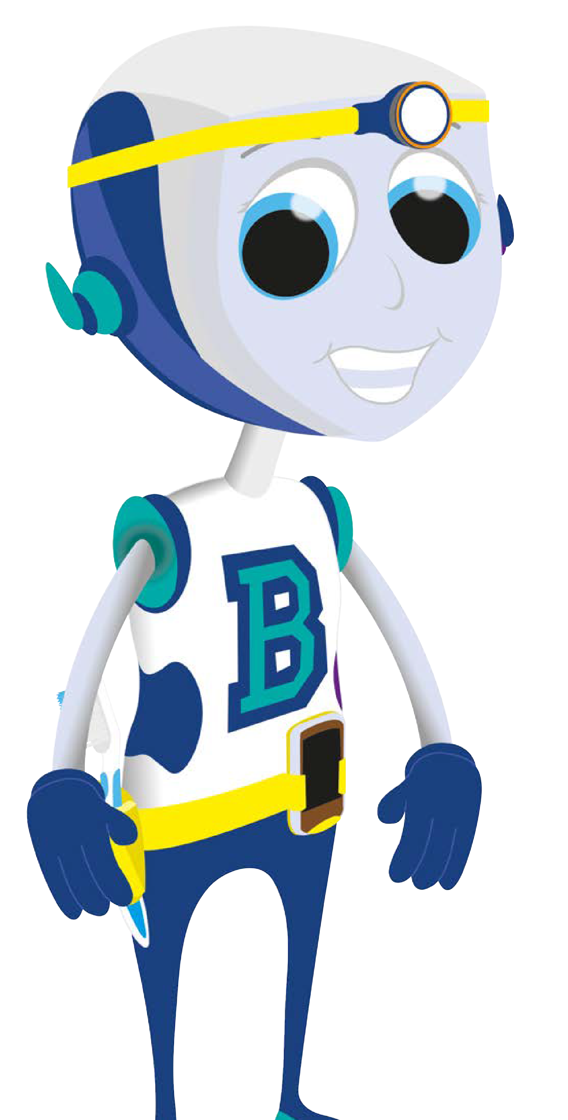
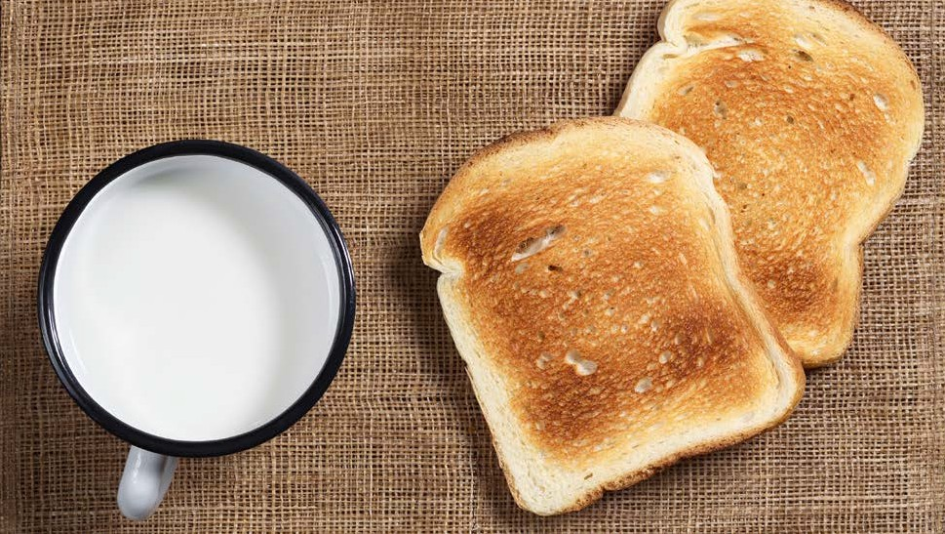
So it is important to cut down how often we have sweet and sugary
snacks and drinks and choose a healthier snack instead.
© Oral Health Foundation www.dentalhealth.org

Slide 10
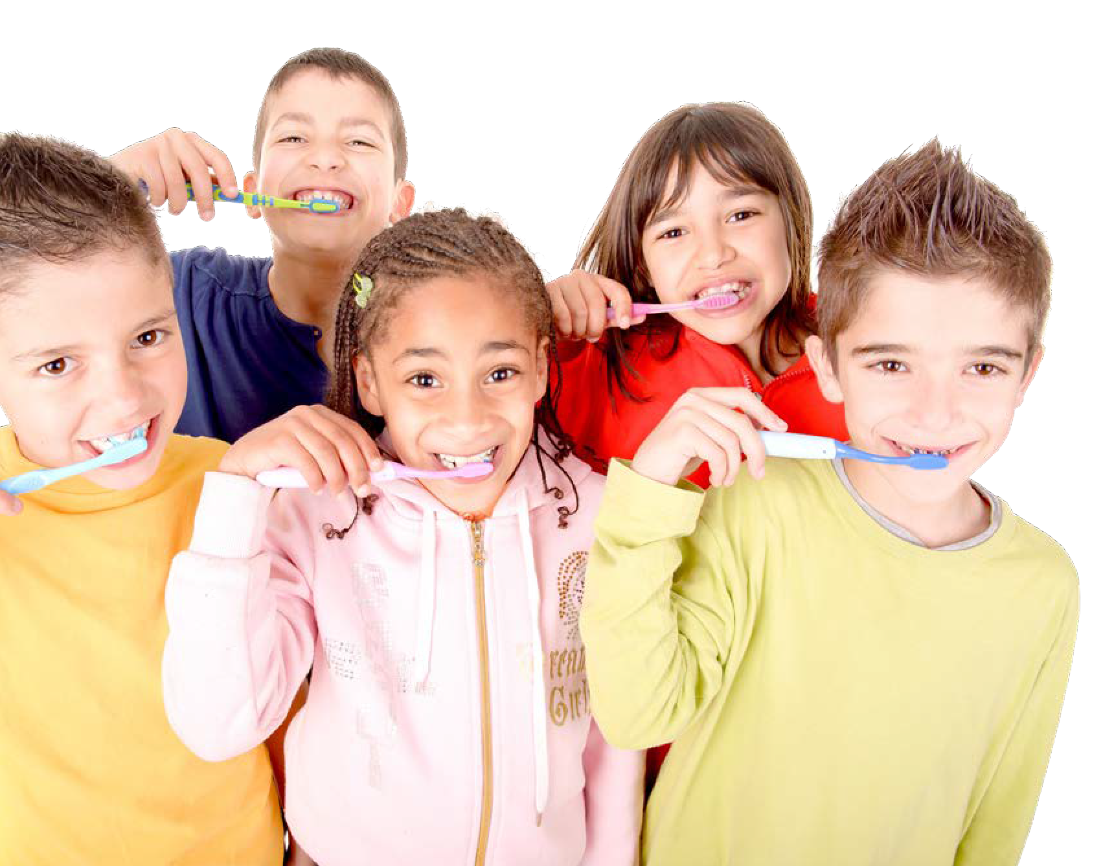
And it’s also important to clean away the bugs on your teeth by brushing every day.
Did you
remember to brush this morning?
© Oral Health Foundation www.dentalhealth.org

Slide 11
For strong and healthy teeth: You should brush your teeth for 2 minutes, at bedtime and at least one other time during the day, with a fluoride toothpaste.
© Oral Health Foundation www.dentalhealth.org

