Slide 1



Diet &
Snacking

Slide 2



We should all eat a healthy diet.
This helps to keep our bodies healthy. It also helps to keep our teeth strong.
© Oral Health Foundation www.dentalhealth.org

Slide 3




































A balanced diet
should contain lots of different foods.
Raisins
t
P
a o
s
o
e
t
C
p
a
h
d
o
e
t
p
s
o
m
e
o
t
Whole
Cous
grain
Cous
cereal
o
B
g
e
s
n
a
l
F
e
r
z
e
a
Whole wheat
p
s
pasta
r
P
i
e
o
d
g
r
Lentils
e
l n
s
B
n
a
w a
u
r
l
e
o
s
t
L
t
o
a
a
d
w
f
Spaghetti
s
h
e
o
s
f
e
s
r
t
c
e
a
u
a
g
T
n
Lean
P
n
ai
n
C
mince
l
k
c
i
h
s
p
t
u
s
a
e
Semi
Soya
skimmed
milk
drink
i
P
n f
l
a
L
w
t
y
o
a
o
t
r
g
h
u

Slide 4


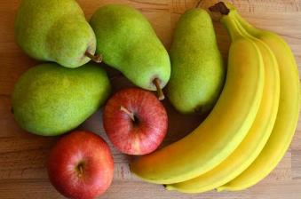
At least 5 fruits and vegetables every day to keep you healthy.
© Oral Health Foundation www.dentalhealth.org

Slide 5

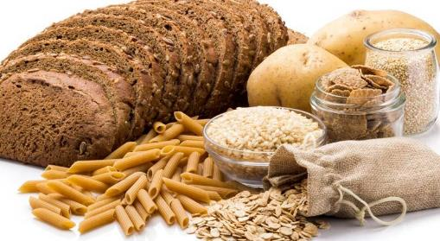
Plenty of starchy foods like bread, potatoes, cereals, pasta, rice.
© Oral Health Foundation www.dentalhealth.org

Slide 6


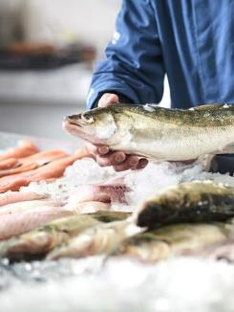
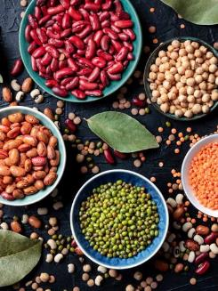
Some protein such as meat, pulses, and beans. Fish is really good for us.
© Oral Health Foundation www.dentalhealth.org

Slide 7


Milk and dairy foods like cheese and yoghurt are very good for strong
healthy teeth.
© Oral Health Foundation www.dentalhealth.org

Slide 8


A tiny bit of
oils and fats.
© Oral Health Foundation www.dentalhealth.org

Slide 9












What are our favourite foods and which part of the eatwell plate do they belong?
Raisins
t
P
a o
s
o
e
t
C
h
p
d
o
e
p
t
a
s
o
m
e
o
t
Whole
Cous
grain
Cous
cereal
g
o
B
e
s
n
a
l
F
e
r
z
e
p
a
Whole wheat
s
r
pasta
P
i
e
o
d
g
Lentils
r
e
l n
s
B
n
a
w a
u
r
l
e
o
s
t
L
t
o
a
w
f
Spaghetti
a
d
s
h
e
o
s
f
e
s
r
t
c
e
a
u
a
g
P
n
T
n
Lean
ai
n
C
mince
l
k
c
i
h
p
g i
s s
t a
u e
V
e
l
Semi
O
skimmed
Soya
Lower fat
i
milk
r s
i
spread
C
s
n f
p
drink
w
P
l
L
a
t
y
o
a
o
t
r
u
Sauce
g
h

Slide 10



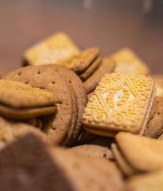



Many foods and drinks we like have lots of sugar in them, such as cake, biscuits and fizzy drinks.
These are not good for our teeth.
© Oral Health Foundation www.dentalhealth.org

Slide 11
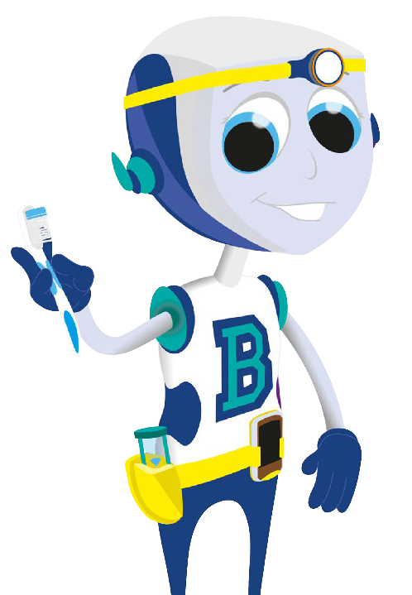
Every day, plaque forms on our teeth, this is soft sticky stuff that you don’t really see. But you brush it off when you clean your teeth.
Plaque contains lots of bugs
© Oral Health Foundation www.dentalhealth.org

Slide 12

The bugs like to feed on sugary foods and drinks and produce plaque acid.
This plaque acid
can cause holes (called cavities) to
This is called dental decay.
© Oral Health Foundation www.dentalhealth.org
form in our teeth.

Slide 13


So if we don’t have many sugary foods and drinks, then the bugs can’t feed on the sugar and our teeth will be strong and healthy.
© Oral Health Foundation www.dentalhealth.org

Slide 14

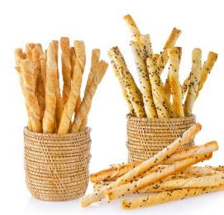

If you need a snack then try breadsticks, nuts or vegetable sticks like
carrots, cucumbers and peppers.
© Oral Health Foundation www.dentalhealth.org

