Slide 1


Our Smile

Slide 2
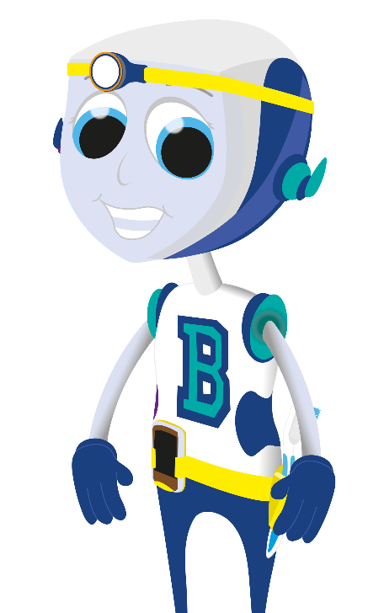










Our ‘baby’ teeth start to come through (erupt) when we are around 6 months old. We normally have 20 ‘baby’ teeth by the time we are 2.5 years old.
Upper Teeth
Central Incisor
Lateral Incisor
Canine
First Molar
Second Molar
Lower Teeth
Second Molar
First Molar
Canine
Lateral Incisor
Central Incisor
© Oral Health Foundation www.dentalhealth.org

Slide 3
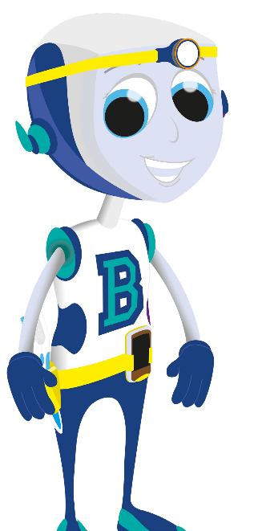
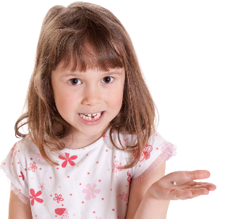
When we are about 6 years old, or older, we start to get our ‘adult’ teeth.
This normally starts with the teeth at the front of our mouths. Each one will become a little loose, then a bit ‘wobbly’.
© Oral Health Foundation www.dentalhealth.org

Slide 4
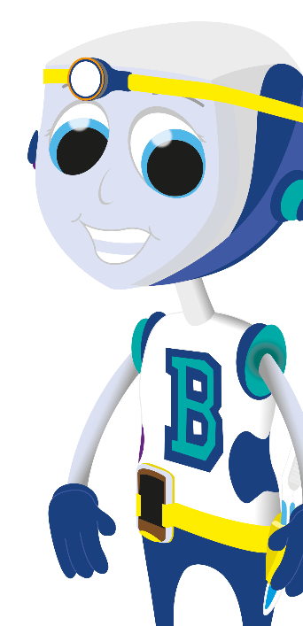
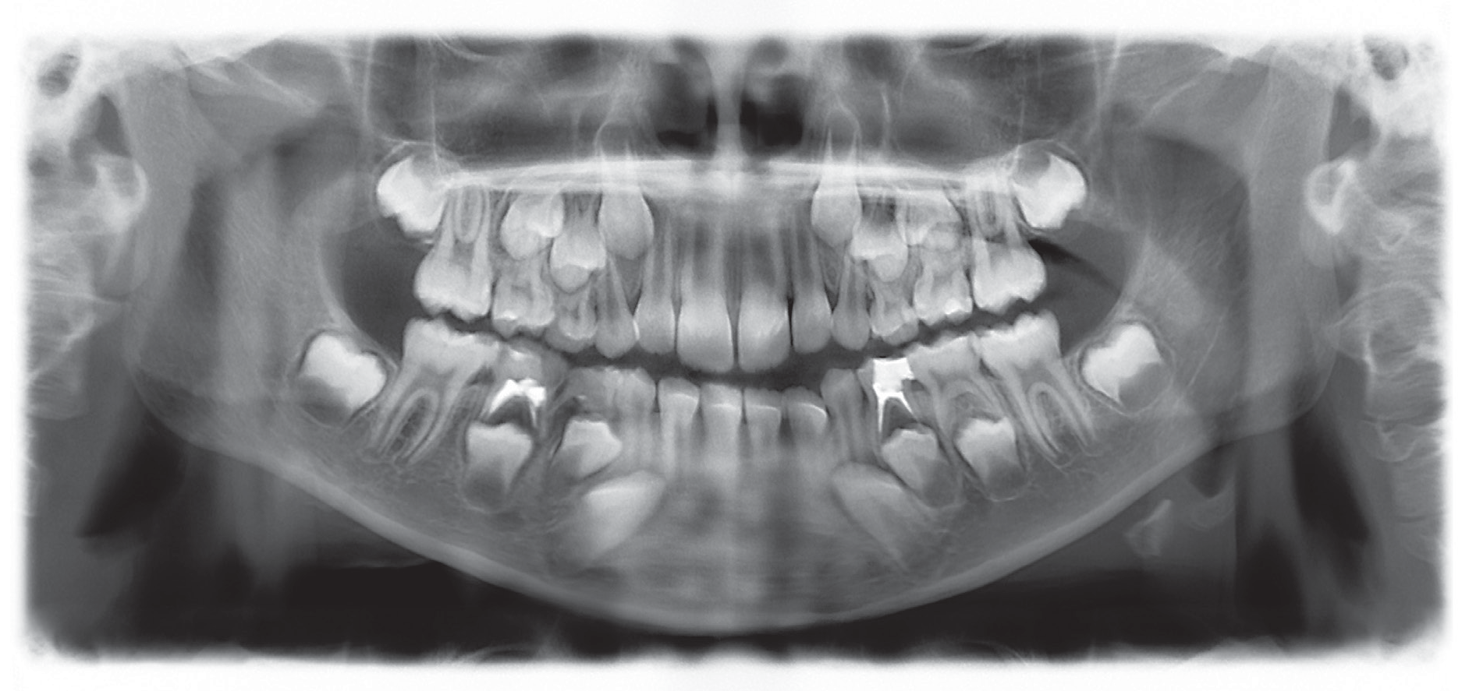
This is because the ‘adult’ teeth are growing underneath and pushing the ‘baby’ teeth out of the way.
It can take
many weeks or even months before they are ready to fall out.
© Oral Health Foundation www.dentalhealth.org

Slide 5

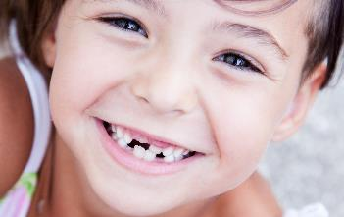
There is no reason to be worried about wobbly teeth, it just means that we are growing up.
Our baby teeth continue to wobble out until we are about 12 years old, then we should have 28 teeth.
© Oral Health Foundation www.dentalhealth.org

Slide 6
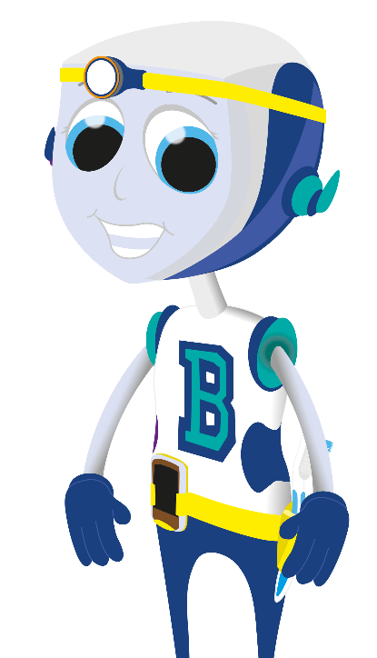

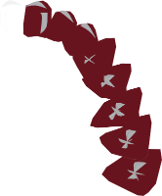




We get 4 more molar teeth later, anytime up to around 24 years old, these are called wisdom teeth.
Upper Teeth Central Incisor Lateral Incisor Canine
First Premolar Second Premolar
First Molar Second Molar
Third Molar (wisdom tooth)
Lower Teeth
Third Molar (wisdom tooth)
Second Molar
First Molar
Second Premolar First Premolar Canine
Lateral Incisor Central Incisor
© Oral Health Foundation www.dentalhealth.org

Slide 7
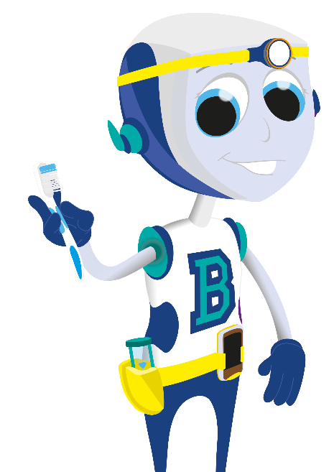

TOOTHBRUSHING
You should brush your teeth, last thing at night, and at least one other time during the day. This takes two minutes.
© Oral Health Foundation www.dentalhealth.org

Slide 8
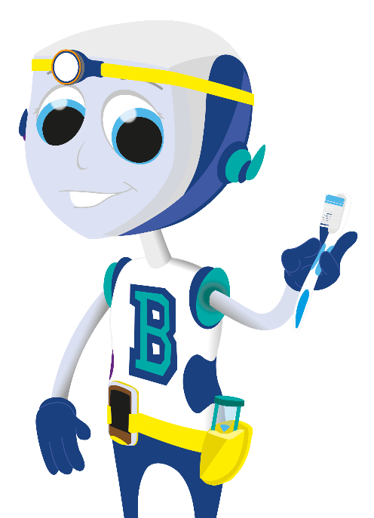
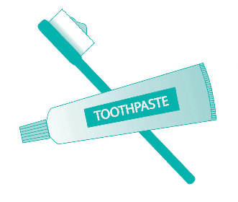
TOOTHBRUSHING
Use a pea-sized amount of fluoride toothpaste on your toothbrush.
© Oral Health Foundation www.dentalhealth.org

Slide 9
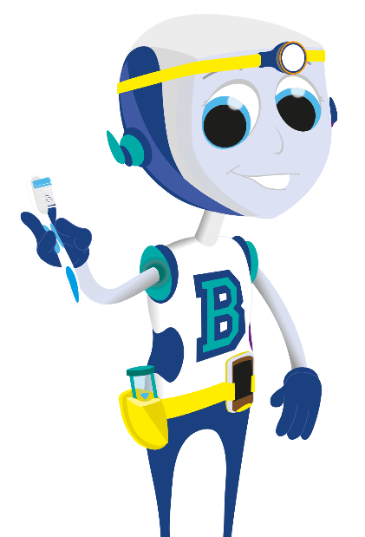
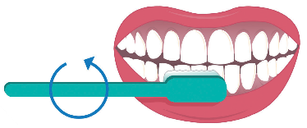
TOOTHBRUSHING
Place the bristles onto your teeth and move the brush in small round movements,
making sure you brush where the tooth meets the gum.
© Oral Health Foundation www.dentalhealth.org

Slide 10
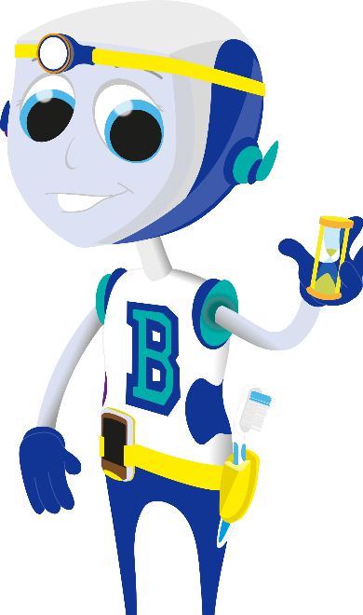
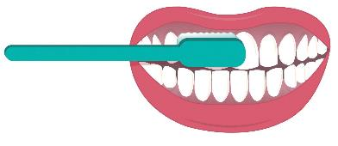
TOOTHBRUSHING
Brush the outside surfaces of each tooth, remembering to brush where the tooth meets the gum.
© Oral Health Foundation www.dentalhealth.org

Slide 11
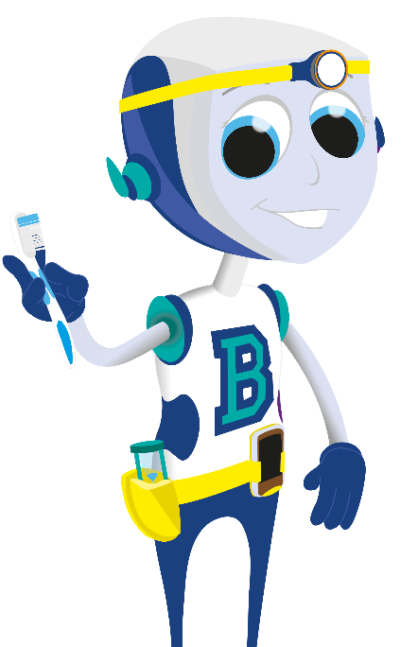
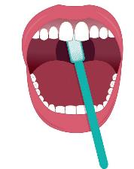
TOOTHBRUSHING
Brush the inside surfaces of each tooth. You can use the tip of the brush on the top and bottom front teeth.
© Oral Health Foundation www.dentalhealth.org

Slide 12
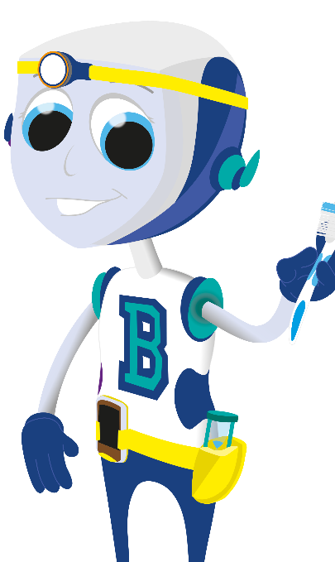
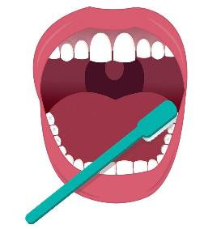
TOOTHBRUSHING
Then brush the biting surface of each tooth (every tooth has 5 sides and they all need cleaning).
© Oral Health Foundation www.dentalhealth.org

Slide 13
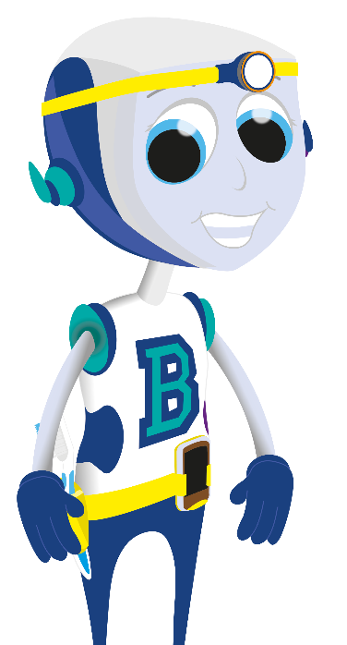
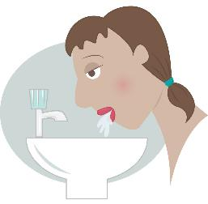
TOOTHBRUSHING
Spit the toothpaste out and
don’t rinse your mouth
out with water.
© Oral Health Foundation www.dentalhealth.org

Slide 14
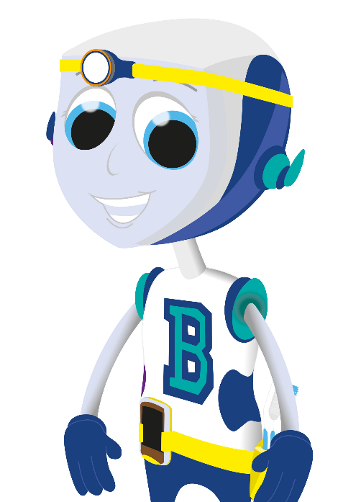
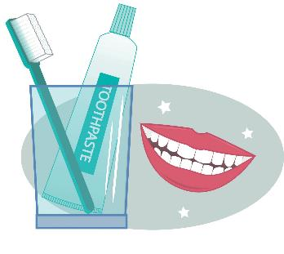
TOOTHBRUSHING
Clean your toothbrush,
put it away and
…SMILE!
© Oral Health Foundation www.dentalhealth.org

