Slide 1


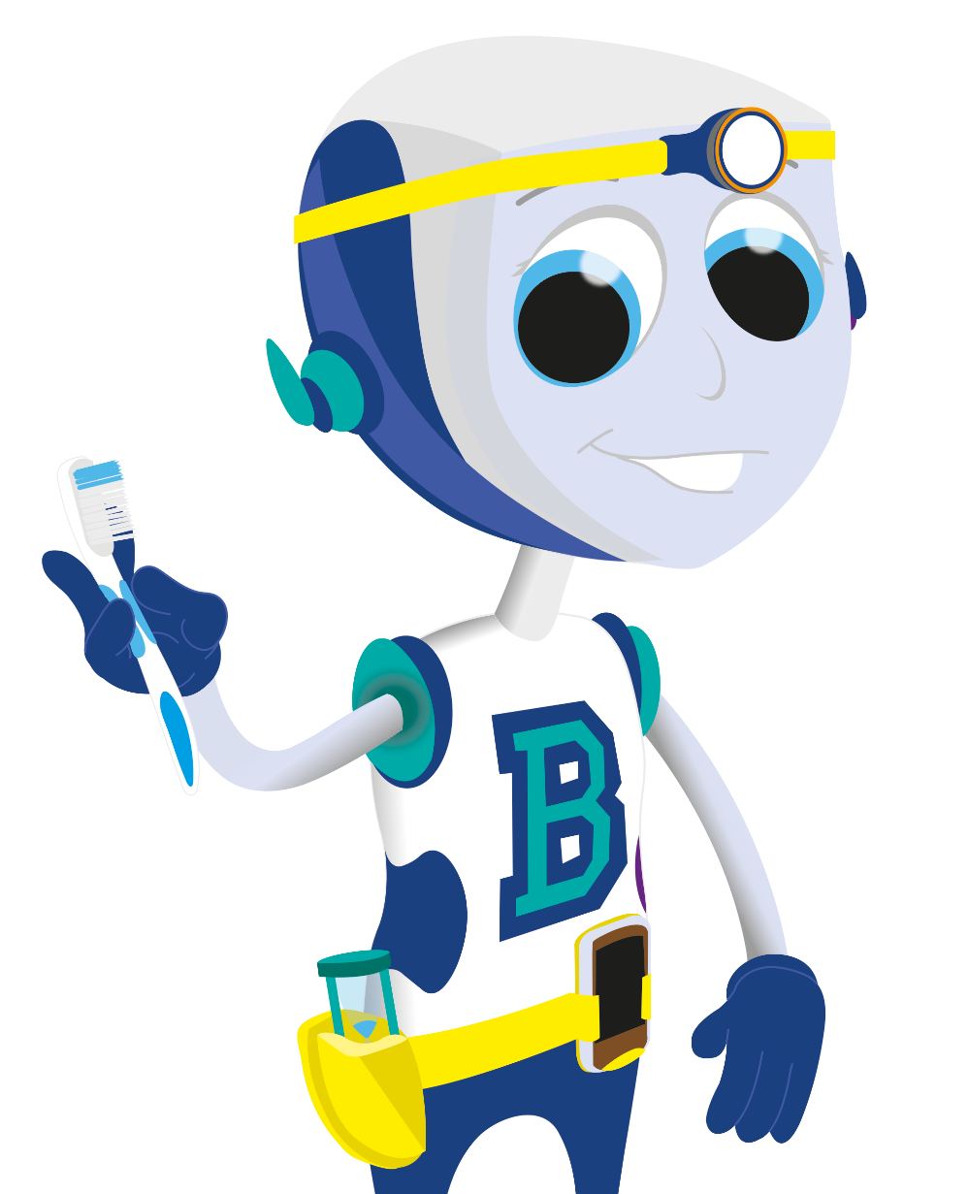

Looking After Our Teeth

Slide 2


What is Dental Decay?
© Oral Health Foundation www.dentalhealth.org

Slide 3

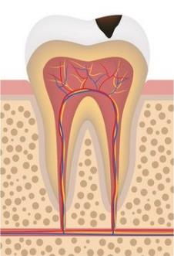
The sugar in our diet reacts with the bacteria in our mouths and forms plaque acids (an acid attack).
These acids soften the enamel and dentine and cause dental decay.
© Oral Health Foundation www.dentalhealth.org

Slide 4

What is plaque?
Plaque is a soft, sticky film that builds up on our teeth and contains millions of bacteria.
© Oral Health Foundation www.dentalhealth.org

Slide 5

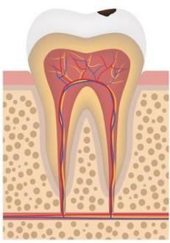
The plaque acids start to attack the enamel on our teeth. Eventually, this will cause a hole (cavity) in the tooth.
© Oral Health Foundation www.dentalhealth.org

Slide 6

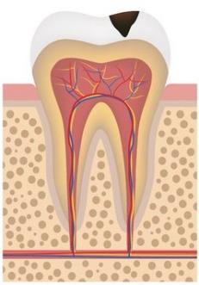
If this is left untreated, the decay will continue further into the tooth.
This may cause the tooth to become painful and this could lead to the tooth having to be taken out (extracted).
© Oral Health Foundation www.dentalhealth.org

Slide 7



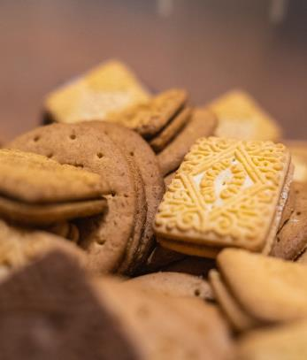
So, if we have less sugary food and drink we will have less tooth decay.
© Oral Health Foundation www.dentalhealth.org

Slide 8

Preventing Dental Decay
© Oral Health Foundation www.dentalhealth.org

Slide 9

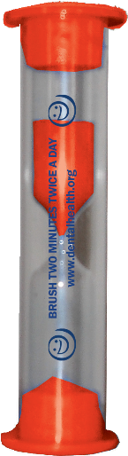
To keep your teeth and gums healthy, you need to brush them for 2 minutes last thing at night and at least one other time during the day, using a fluoride toothpaste.
© Oral Health Foundation www.dentalhealth.org

Slide 10

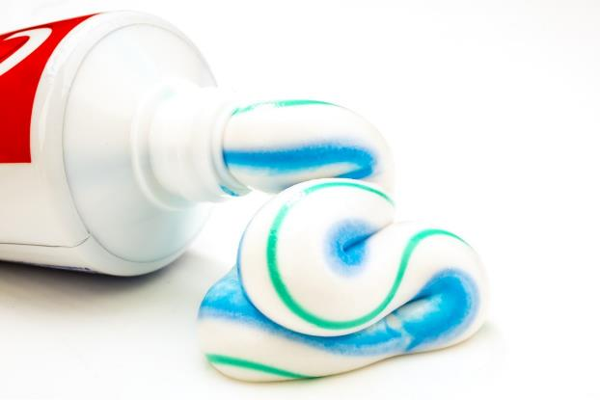
Fluoride is a natural mineral that helps to strengthen the enamel on our teeth and prevent dental decay.
The toothpaste that you use, should contain 1350- 1500 parts per million (PPM) fluoride, to protect your teeth against dental decay.
© Oral Health Foundation www.dentalhealth.org

Slide 11

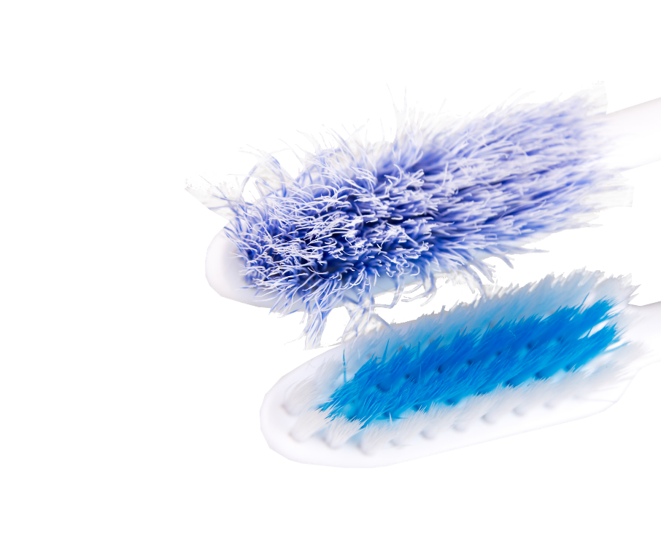
Your toothbrush should have a small head and soft-medium textured filaments (bristles).
You should change your toothbrush every 3 months, or sooner if the filaments loo splayed or worn.
You should also change your toothbrush after you have been poorly.
© Oral Health Foundation www.dentalhealth.org

Slide 12


Having a balanced diet that is low in sugar will help prevent dental
decay.
© Oral Health Foundation www.dentalhealth.org

Slide 13



Milk and water are the best things to drink for dental health.
© Oral Health Foundation www.dentalhealth.org

Slide 14

Dental decay is a preventable disease, if you have a healthy diet and
a good toothbrushing routine.
© Oral Health Foundation www.dentalhealth.org

Slide 15
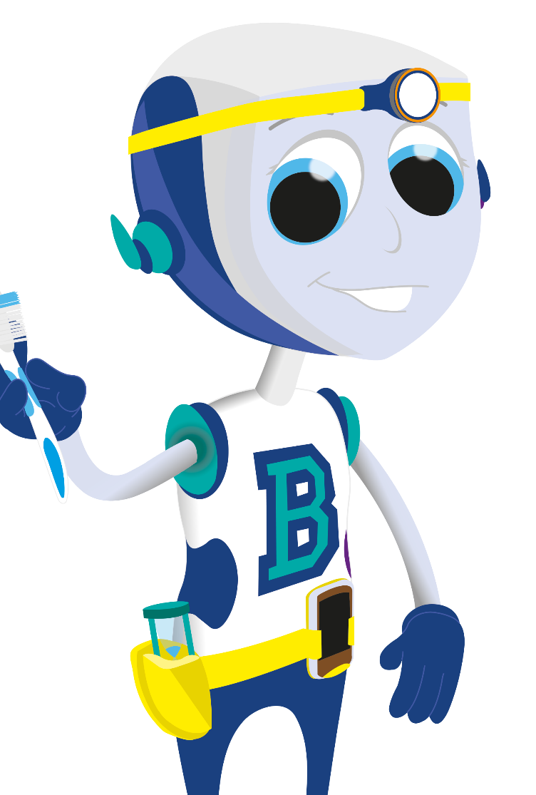
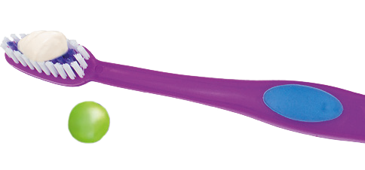

TOOTHBRUSHING
Place a pea-sized blob of fluoride toothpaste on your toothbrush.
© Oral Health Foundation www.dentalhealth.org

Slide 16

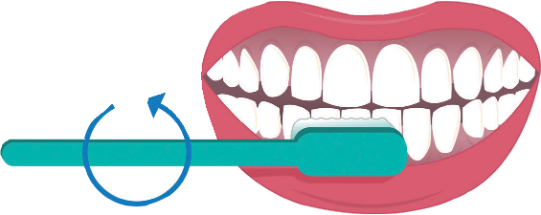
TOOTHBRUSHING
Put the head of the toothbrush at a 45-degree angle by your gumline.
Move the toothbrush in small, circular movements several times on every surface of
the tooth.
© Oral Health Foundation www.dentalhealth.org

Slide 17
TOOTHBRUSHING
Brush the insides, then the outsides and lastly the biting surface of every tooth. Brush along the gum line too.
Spend 2 minutes doing this – don’t rush.
© Oral Health Foundation www.dentalhealth.org

Slide 18


TOOTHBRUSHING
Spit out the excess toothpaste, but do not rinse your mouth as this will wash all of the fluoride off your teeth before it has had chance to work.
g
talhealth.or
.den
w
w w
tion
ounda F
ealth H
al
r O
©

