Slide 1

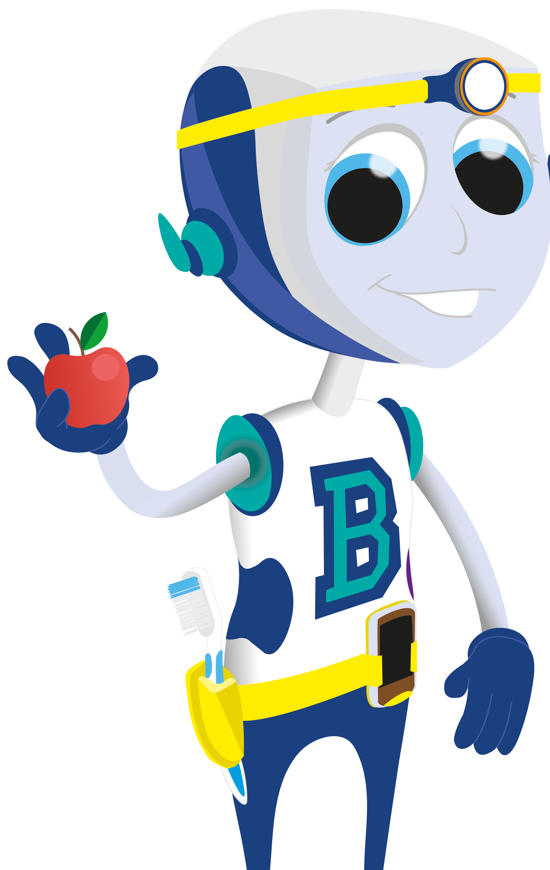




























Sugar & Our Teeth

Slide 2
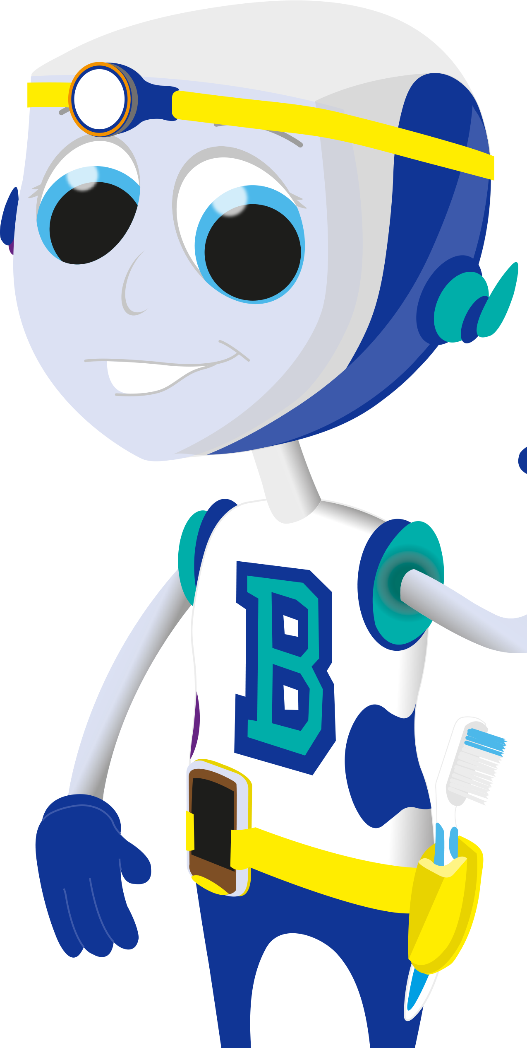
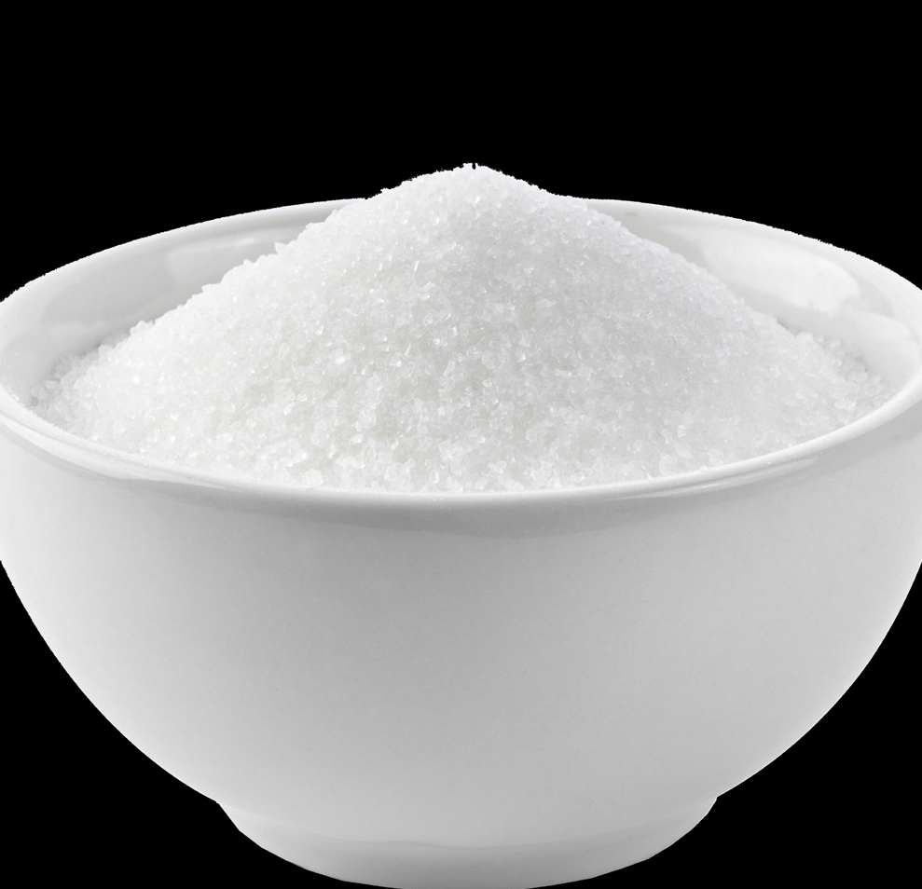
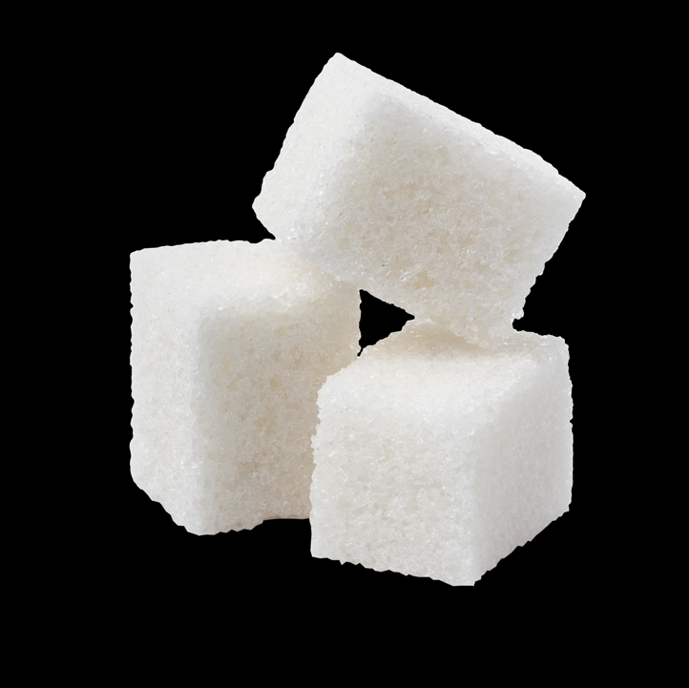
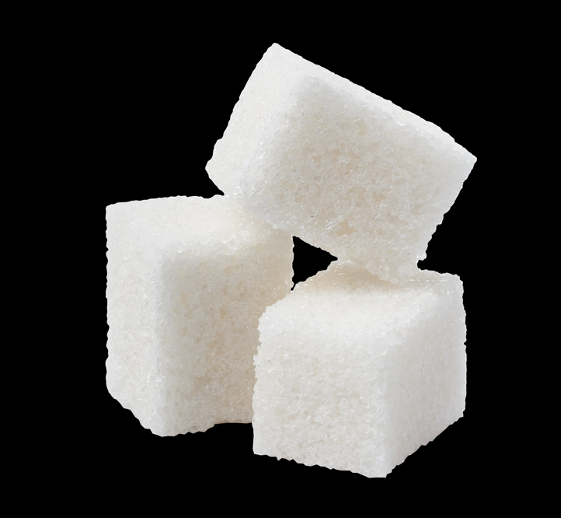

It’s well known that foods and drinks that are high in sugar are bad for our teeth.
© Oral Health Foundation www.dentalhealth.org

Slide 3
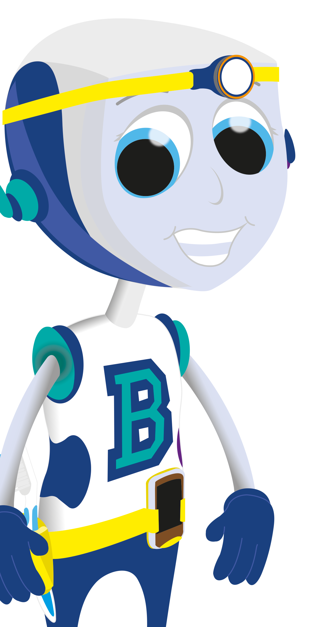
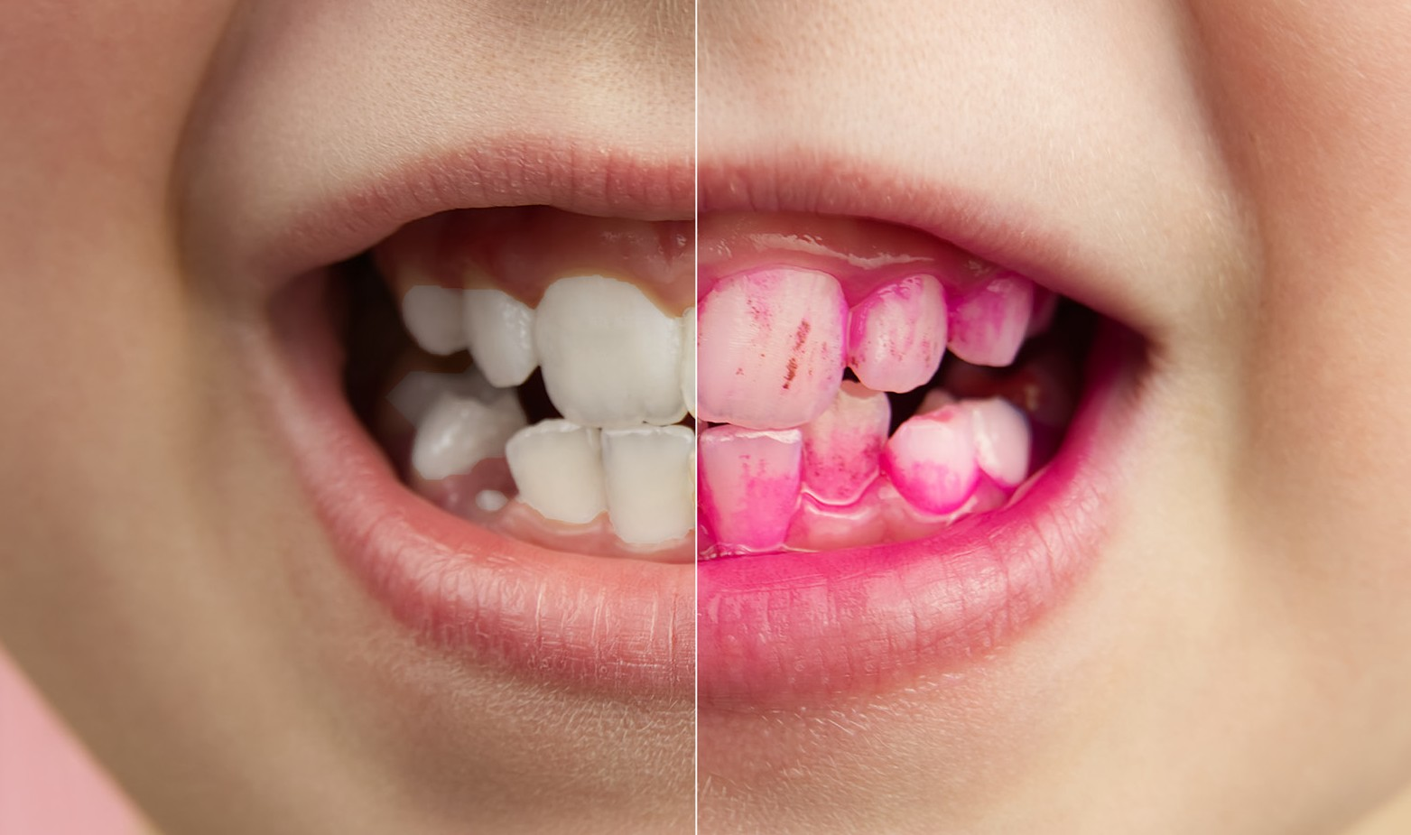
Why? Because the sugar that we eat and drink, reacts with the bad bacteria in our mouth.
This forms plaque (the soft sticky stuff) on our teeth.
© Oral Health Foundation www.dentalhealth.org

Slide 4

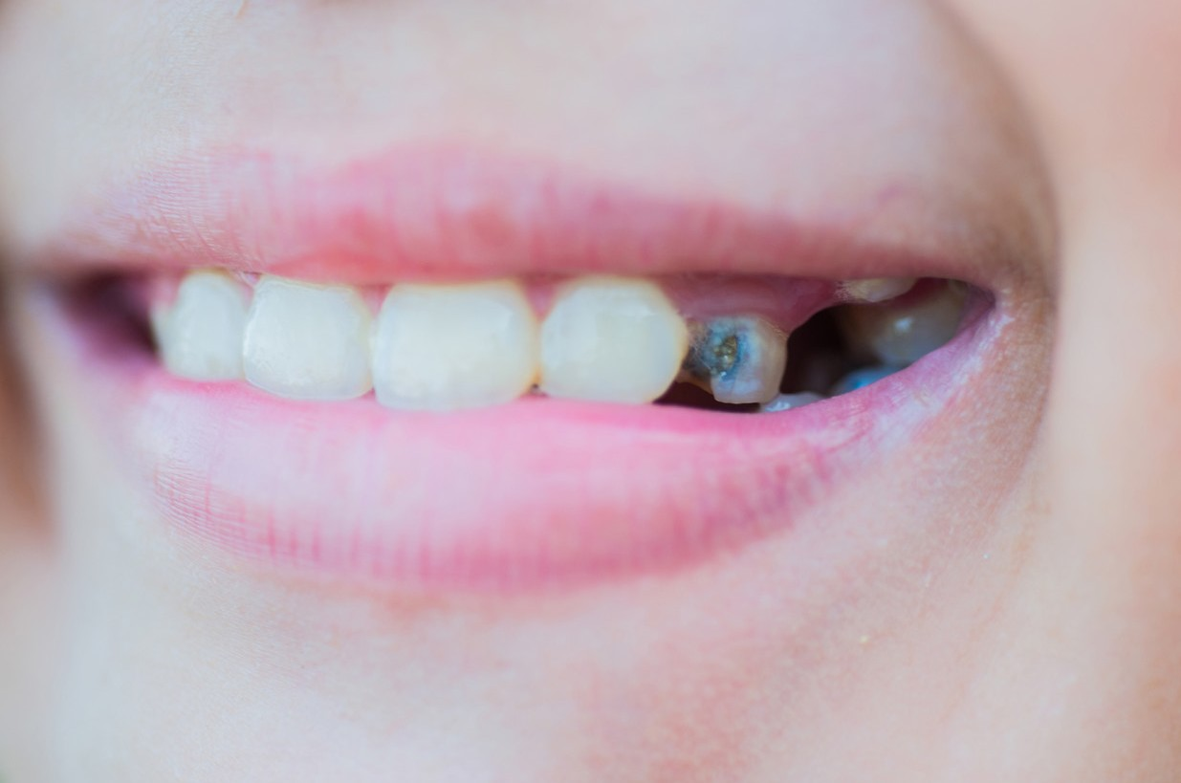
This forms plaque acids and it is this acid that attacks the enamel on our teeth, causing dental decay.
© Oral Health Foundation www.dentalhealth.org

Slide 5
So what happens in our mouth when we
eat or drink?
© Oral Health Foundation www.dentalhealth.org

Slide 6
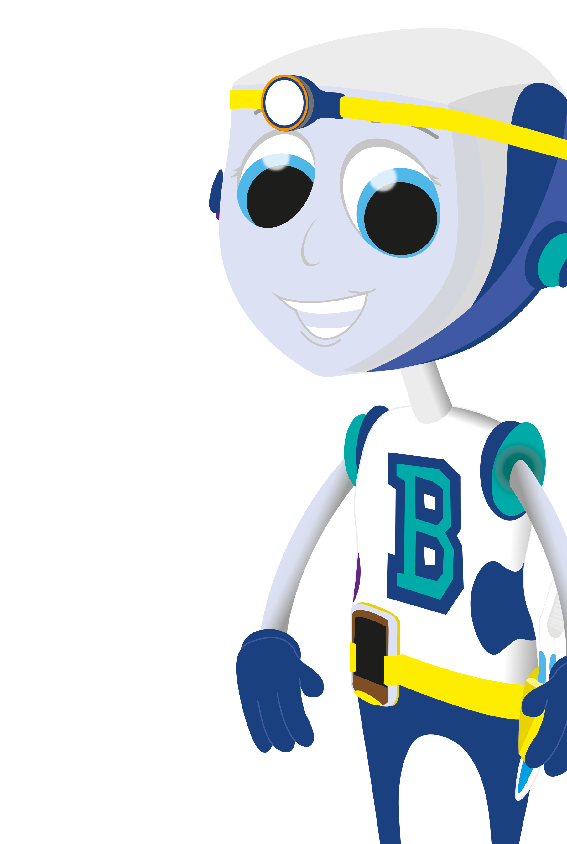
Our mouths are normally
pH 7 (Acid neutral).
How some everyday drinks may erode your teeth
 | pH | Acidity Levels
Cola drinks | 2.5 | High
Carbonated orange | 2.9 | High
Grapefruit juice | 3.2 | High
White wine | 3.7 | Medium
Beer/bitter | 3.9 | Low
Lager | 4.4 | Low
Sparkling water | 5.1 | Low
Tap water | 6.5-9.5 | None
© Oral Health Foundation www.dentalhealth.org

Slide 7
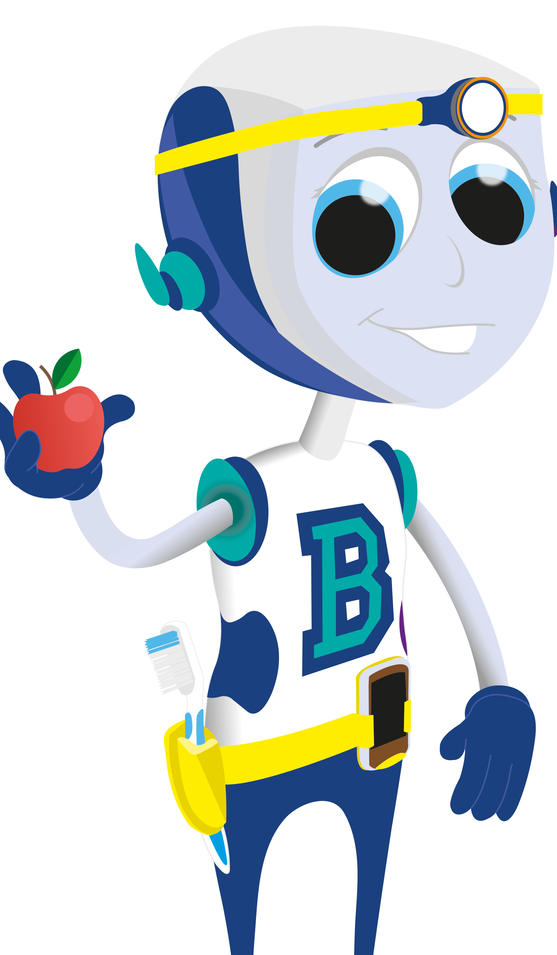
When we eat or drink anything, the bacteria in our mouths feed off the sugars and they release plaque acid.
As we chew food we produce saliva which helps to neutralise the harmful acids and food away from the teeth. This happens every time we eat and drink.
© Oral Health Foundation www.dentalhealth.org

Slide 8
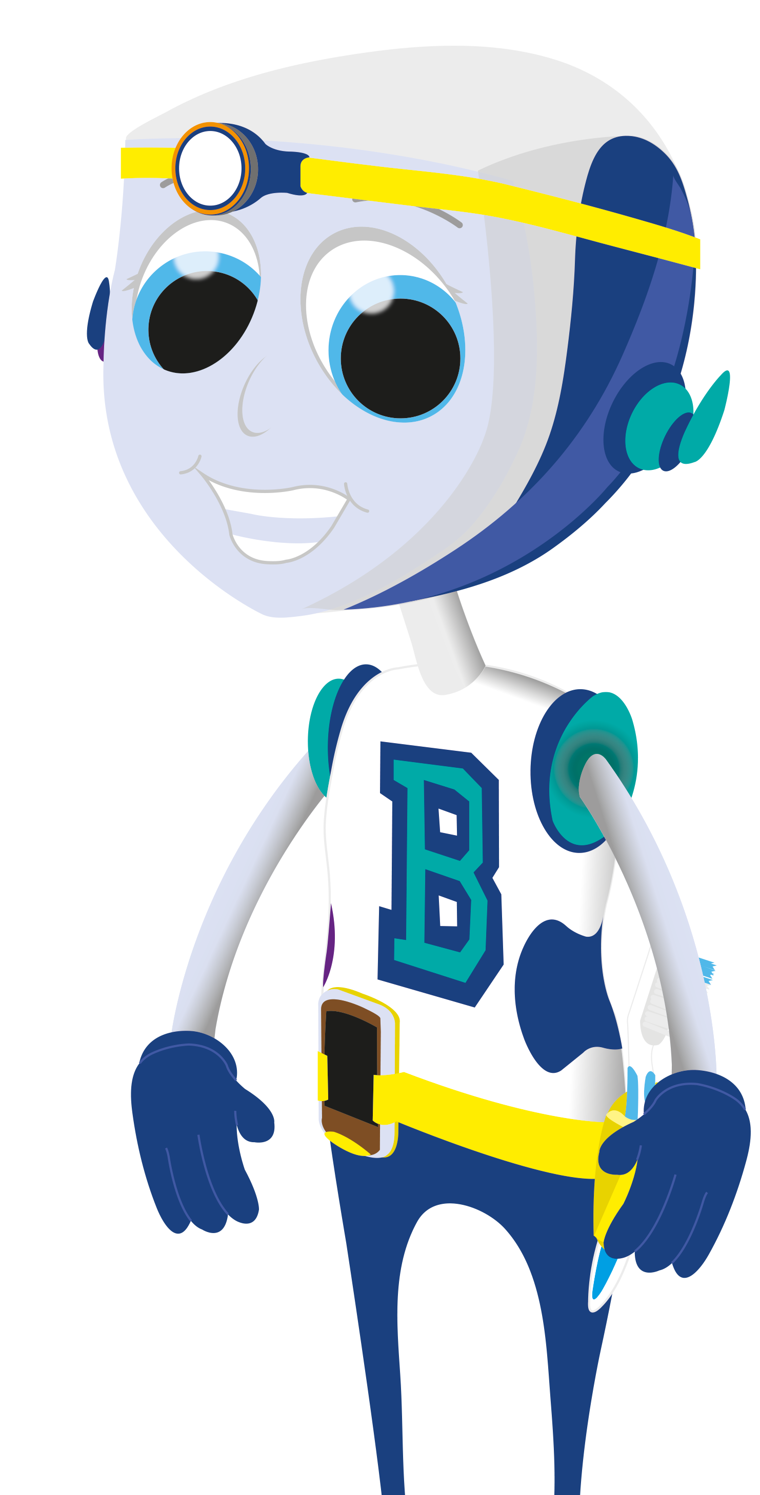
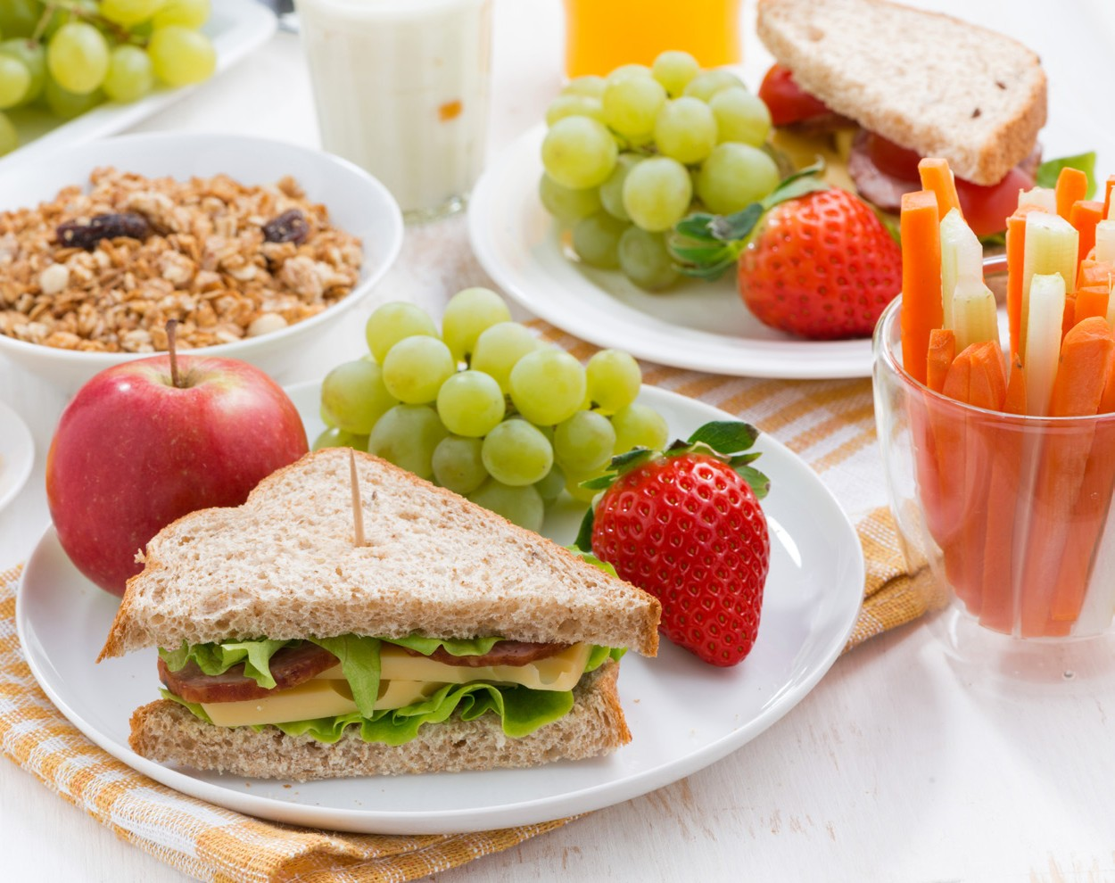
To keep teeth healthy: Eat a balanced diet of three meals and one snack per day.
And use a fluoride toothpaste as part of a good toothbrushing routine.
Regular visits to the dentist will help to keep your mouth healthy and find any problems.
© Oral Health Foundation www.dentalhealth.org

Slide 9
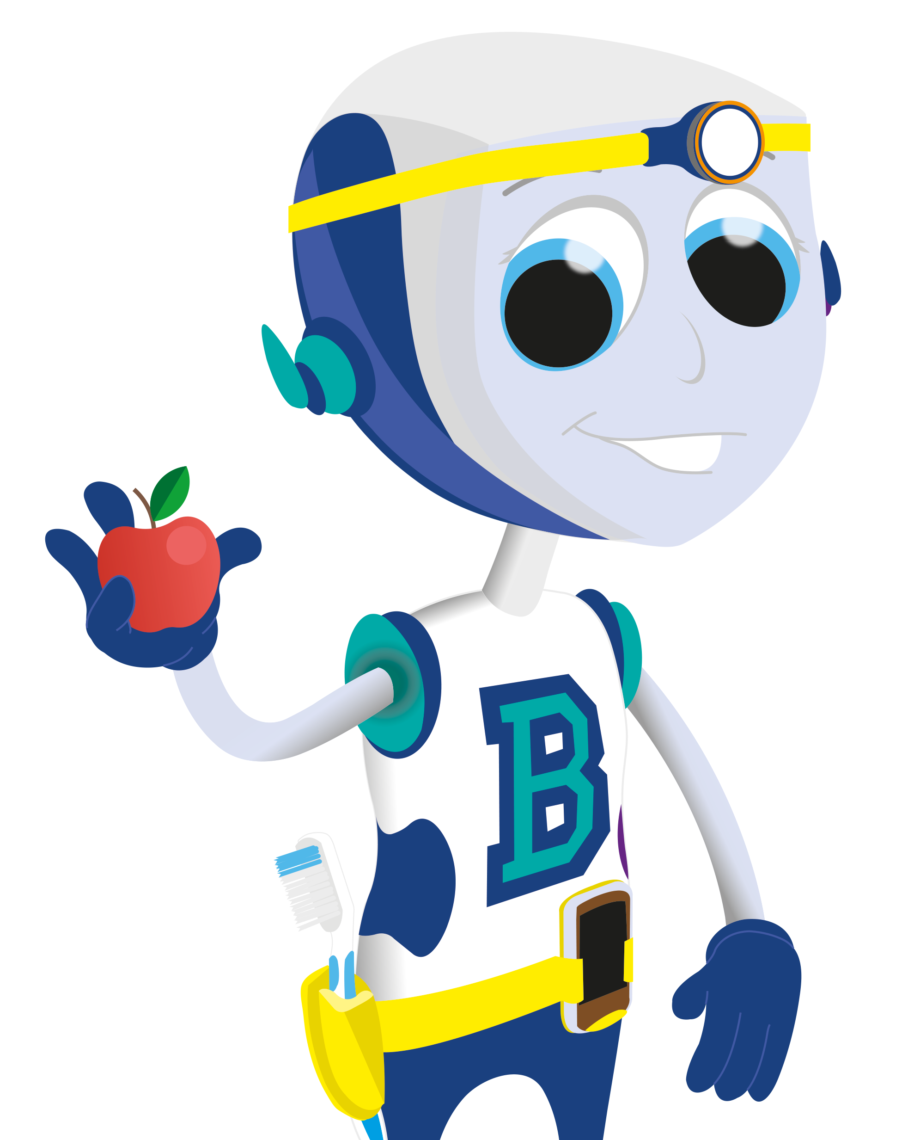
The problems start
when we snack.
© Oral Health Foundation www.dentalhealth.org

Slide 10
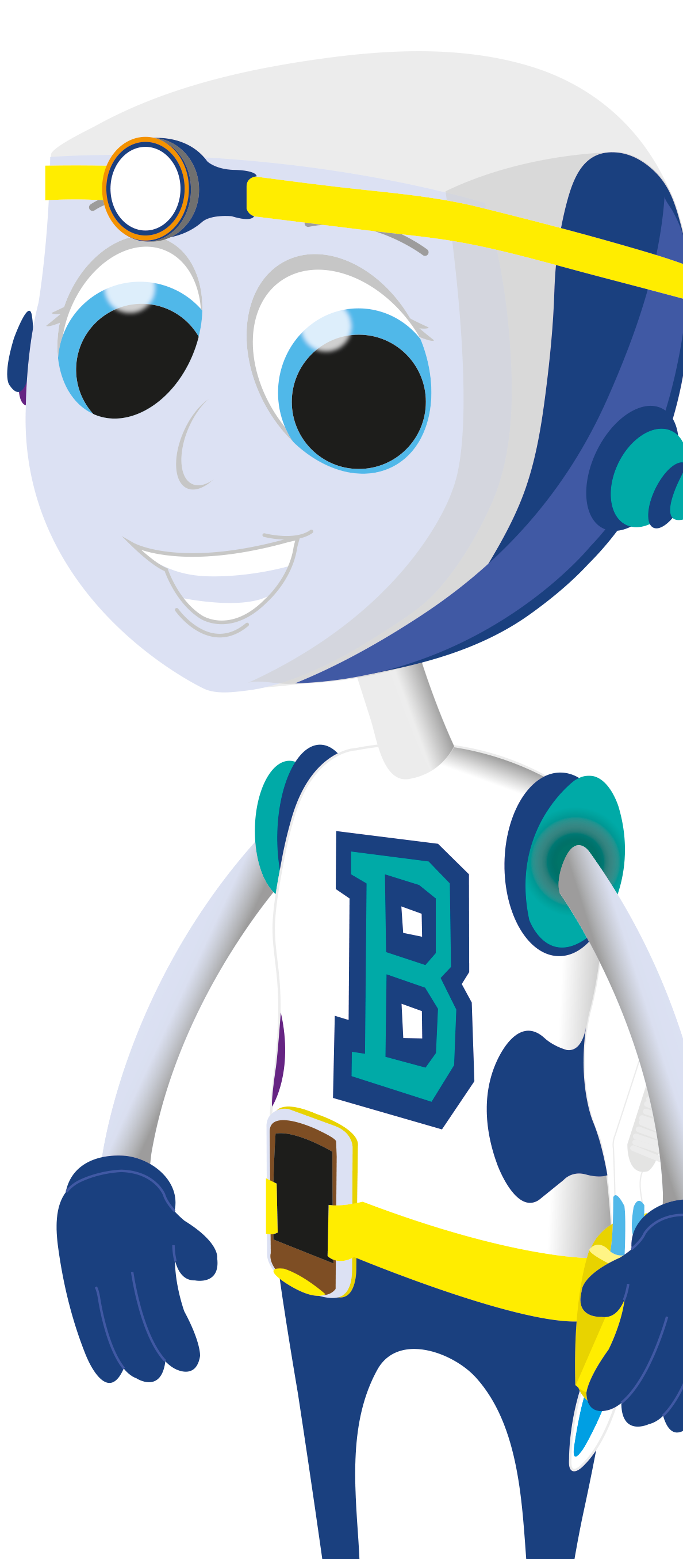
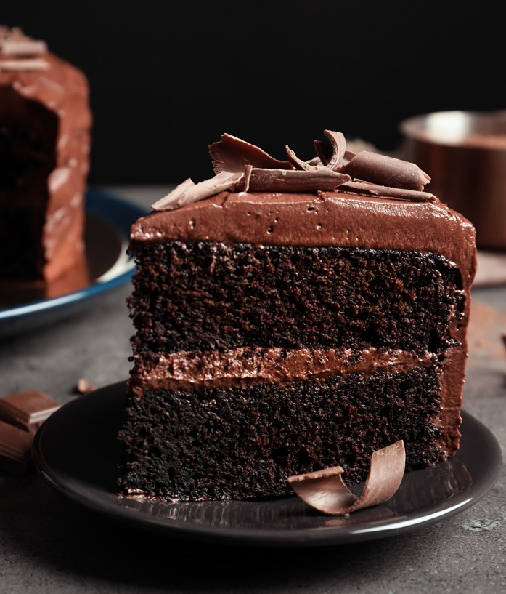
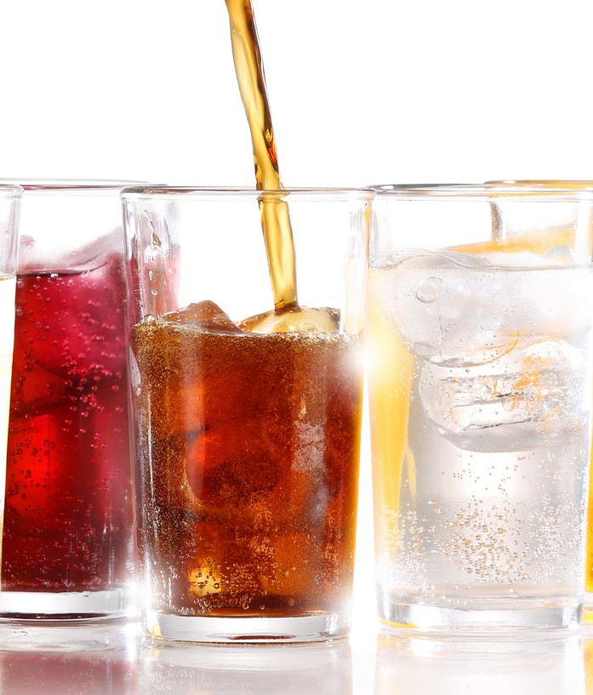
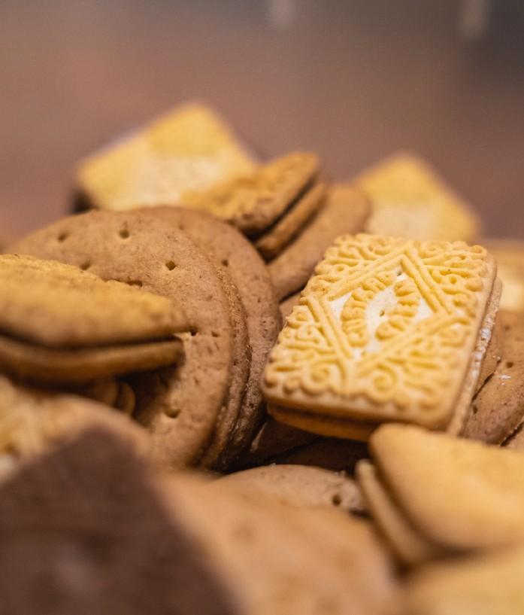
Constant snacking and sugary drinks between meals, means that teeth aren’t getting a break from the acid. And this will lead to tooth decay.
© Oral Health Foundation www.dentalhealth.org

Slide 11
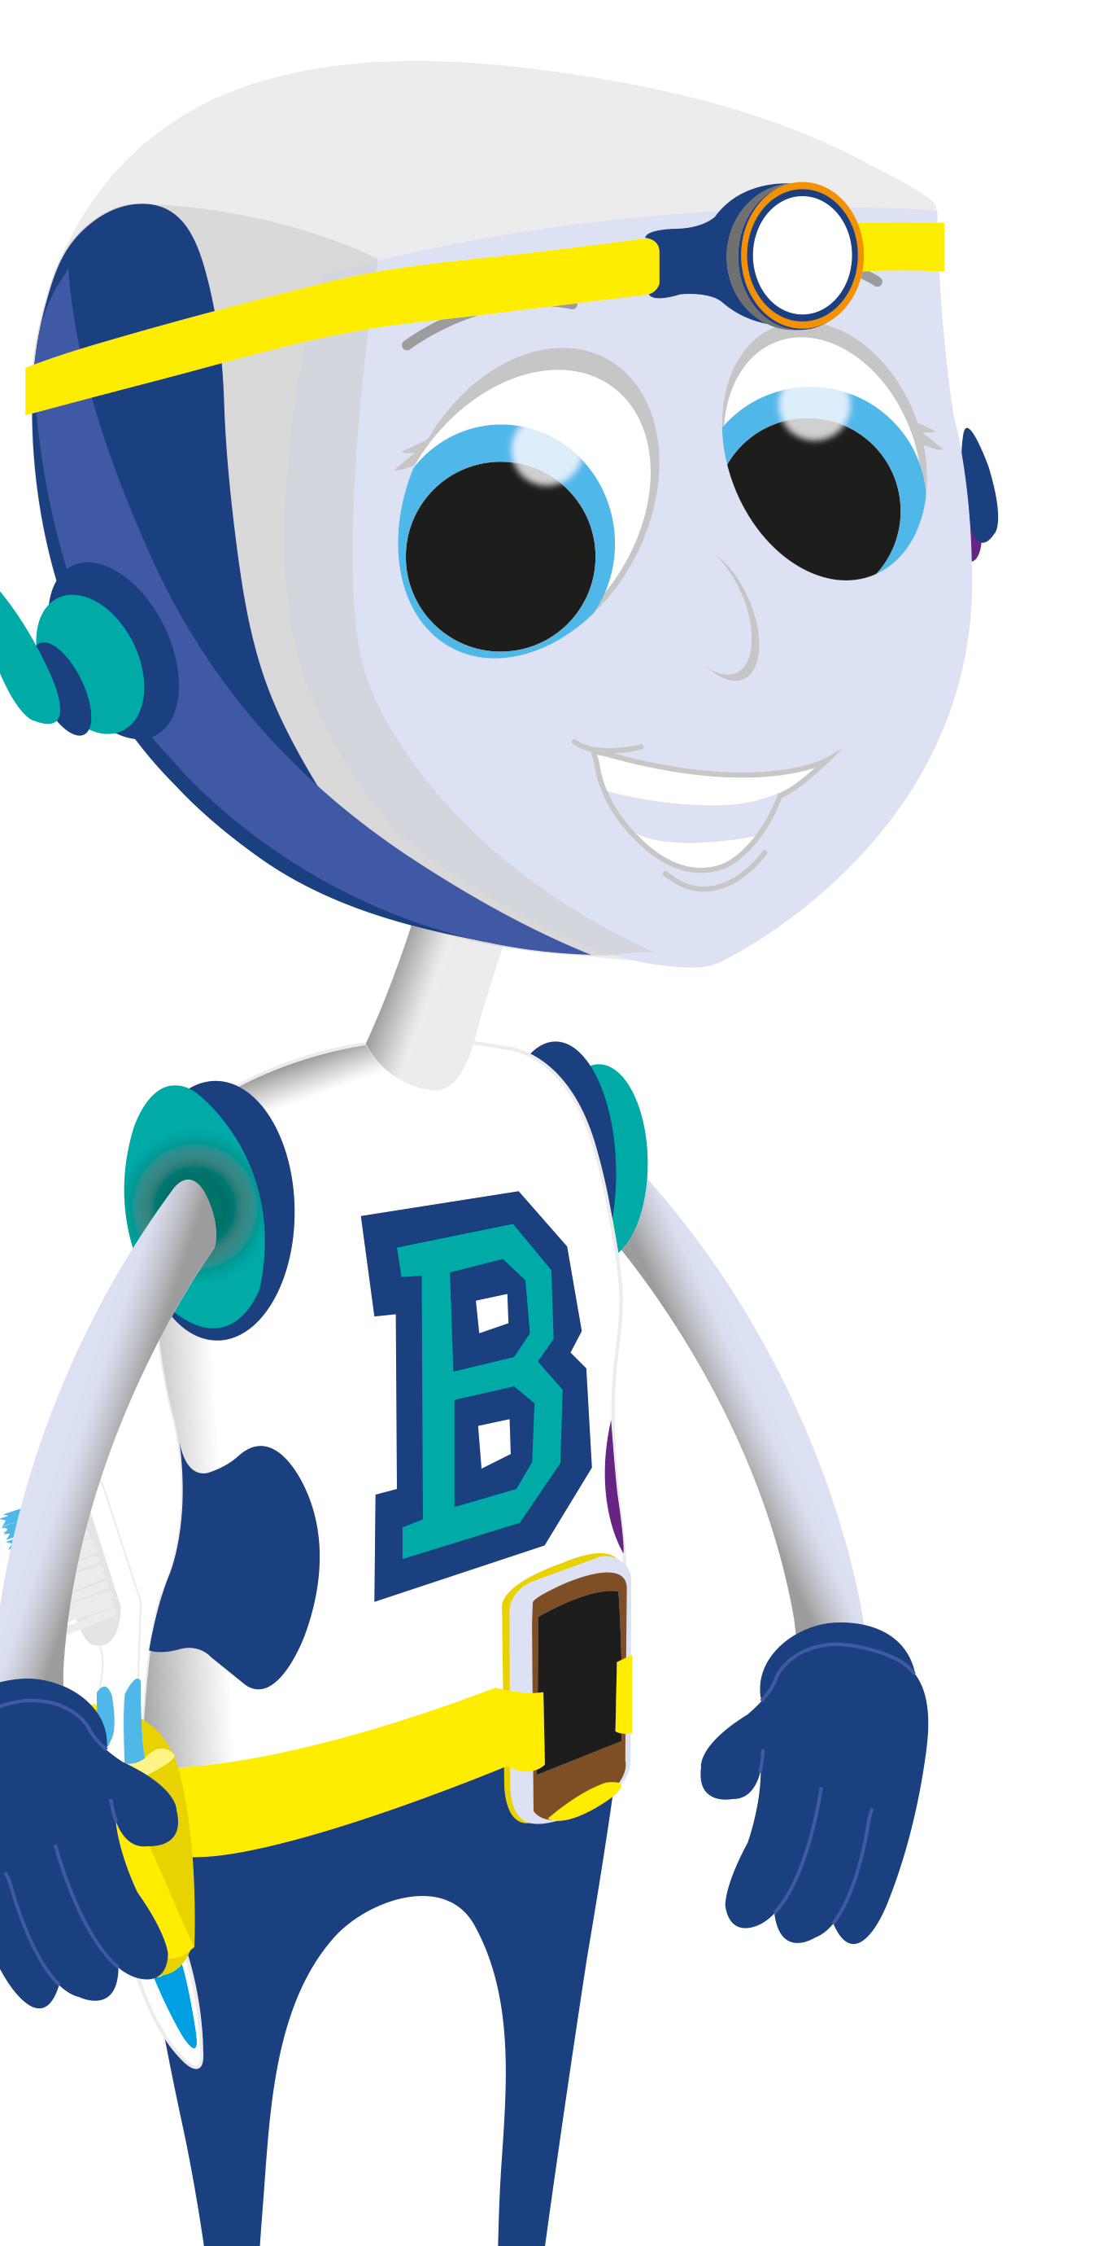
So if you must have sugary foods and drinks, try to have them at mealtimes rather than snacking on them.
If you do snack, then drink water or milk to help lower or dilute the acidity in the mouth.
© Oral Health Foundation www.dentalhealth.org

Slide 12
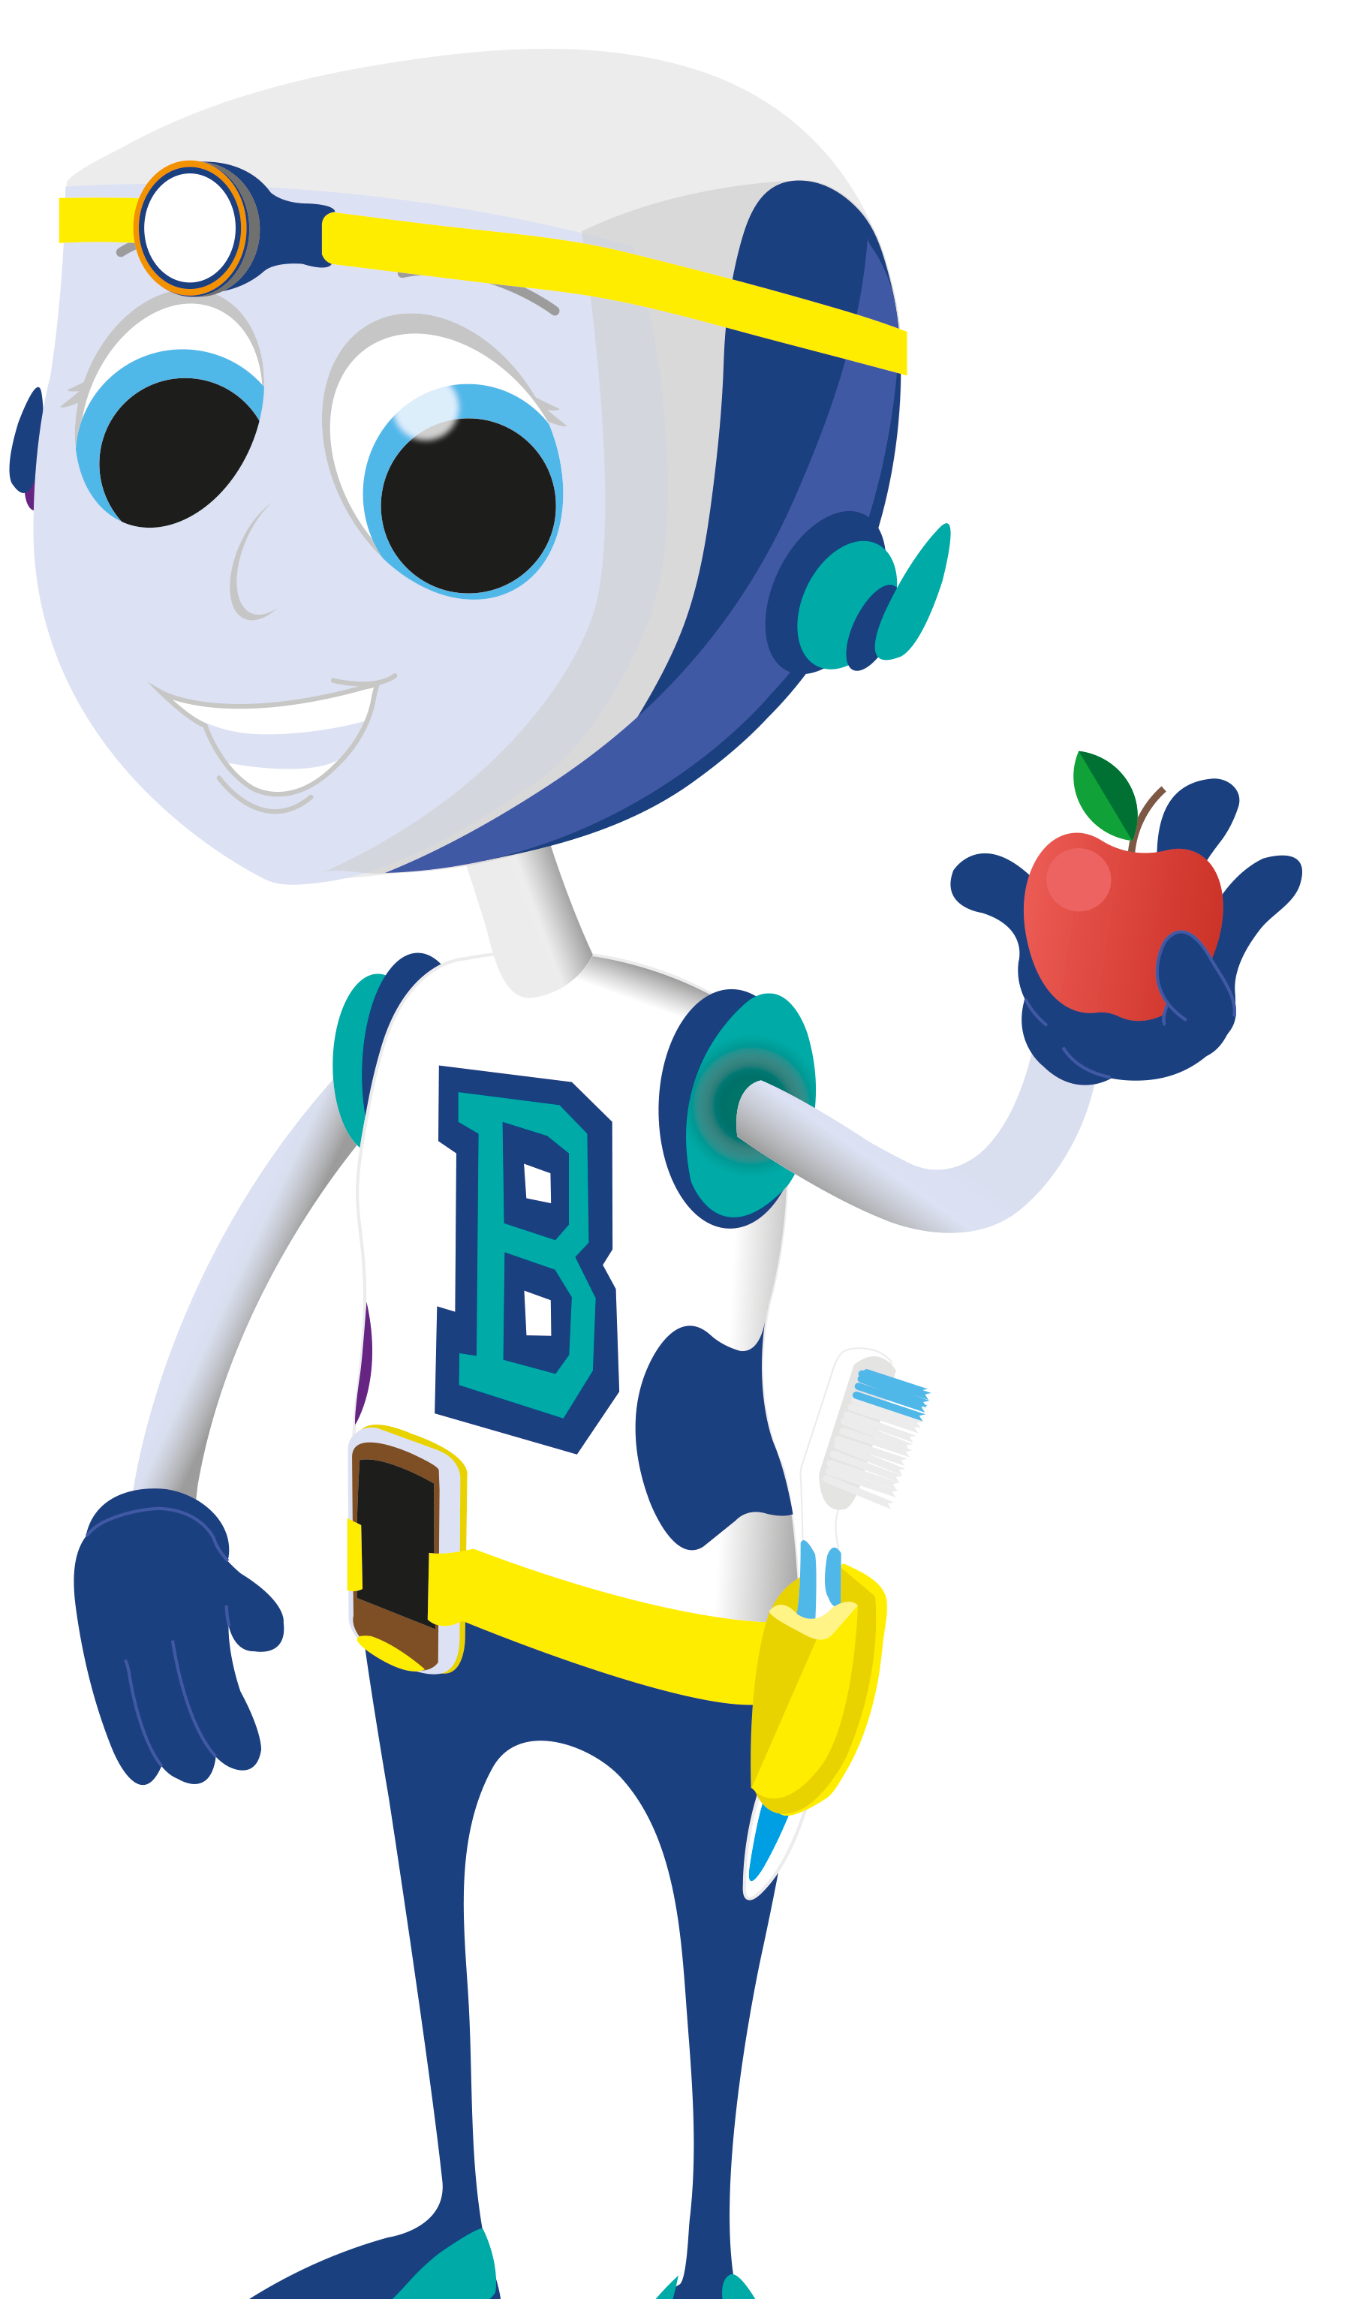
This graph shows what happens to the acid in your mouth when you eat and drink.
The Stephan Curve
7.5
7
6.5
6
5.5
5
4.5
4
3.5
SAFE
© Oral Health Foundation www.dentalhealth.org
pH (acid)
DANGER
Lunch
(acid attack)
Dinner
(acid attack)
Breakfast
Snack
(acid attack)
(acid attack)

Slide 13
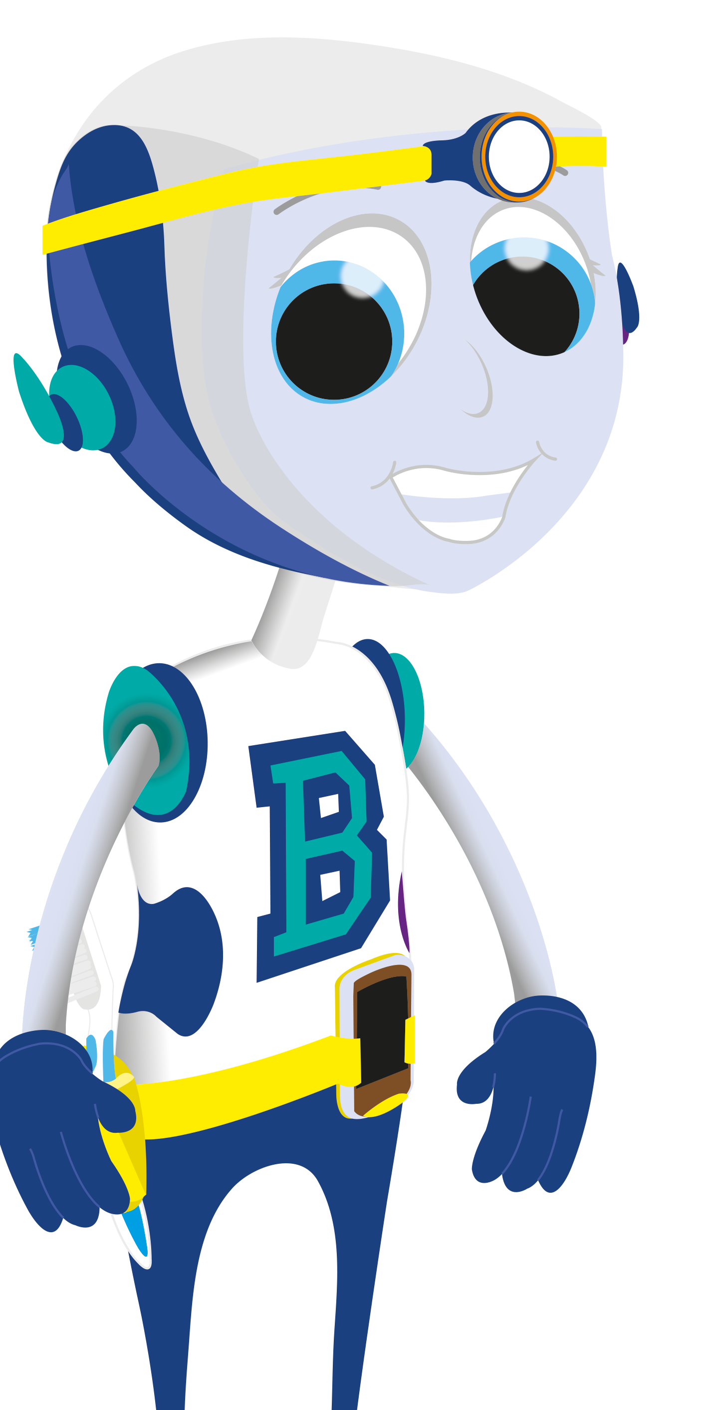
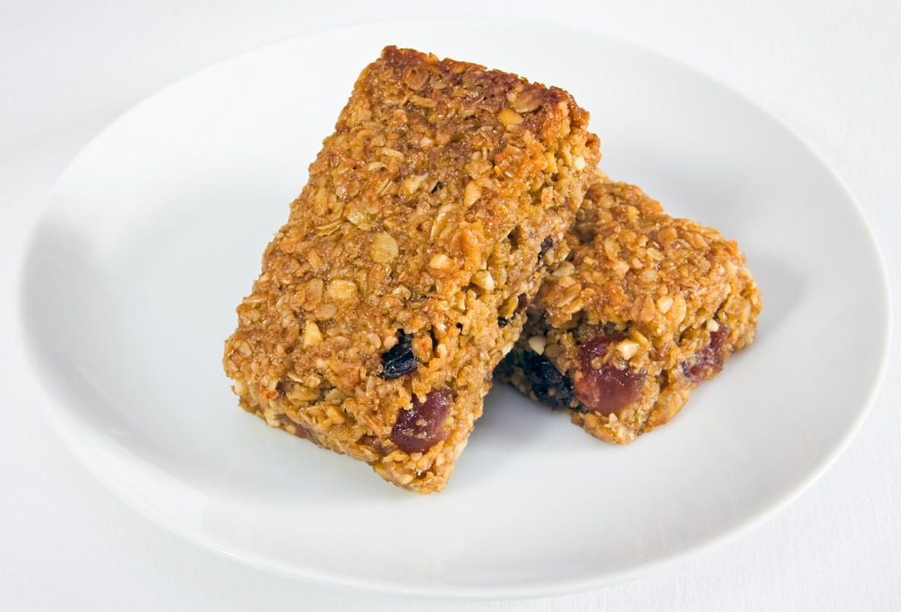
It’s not just flavoured fizzy drinks and
Dried fruit – sticks to
the teeth and is difficult
sweets that damage
to remove – best not as a snack.
Fruit juice – again,
your teeth:
sounds healthy but this is very acidic. Plain
water is much healthier.
Cereal bars – you may think these are healthy but are often packed with sugars and fruits so check the packaging.
© Oral Health Foundation www.dentalhealth.org

